Slide 1
18 participants
Notes:
Analysis:
1. check accoridng to whetehr response itself was repeated ornot repeated for each type of two target trial (collapsing across all 2 target trial types, and with the 1 target trial type )
3. Separate out the response trials wrt to whether the same response or diff response (e.g., cong/cong trials, whether same response as this trial or different response)

Slide 2
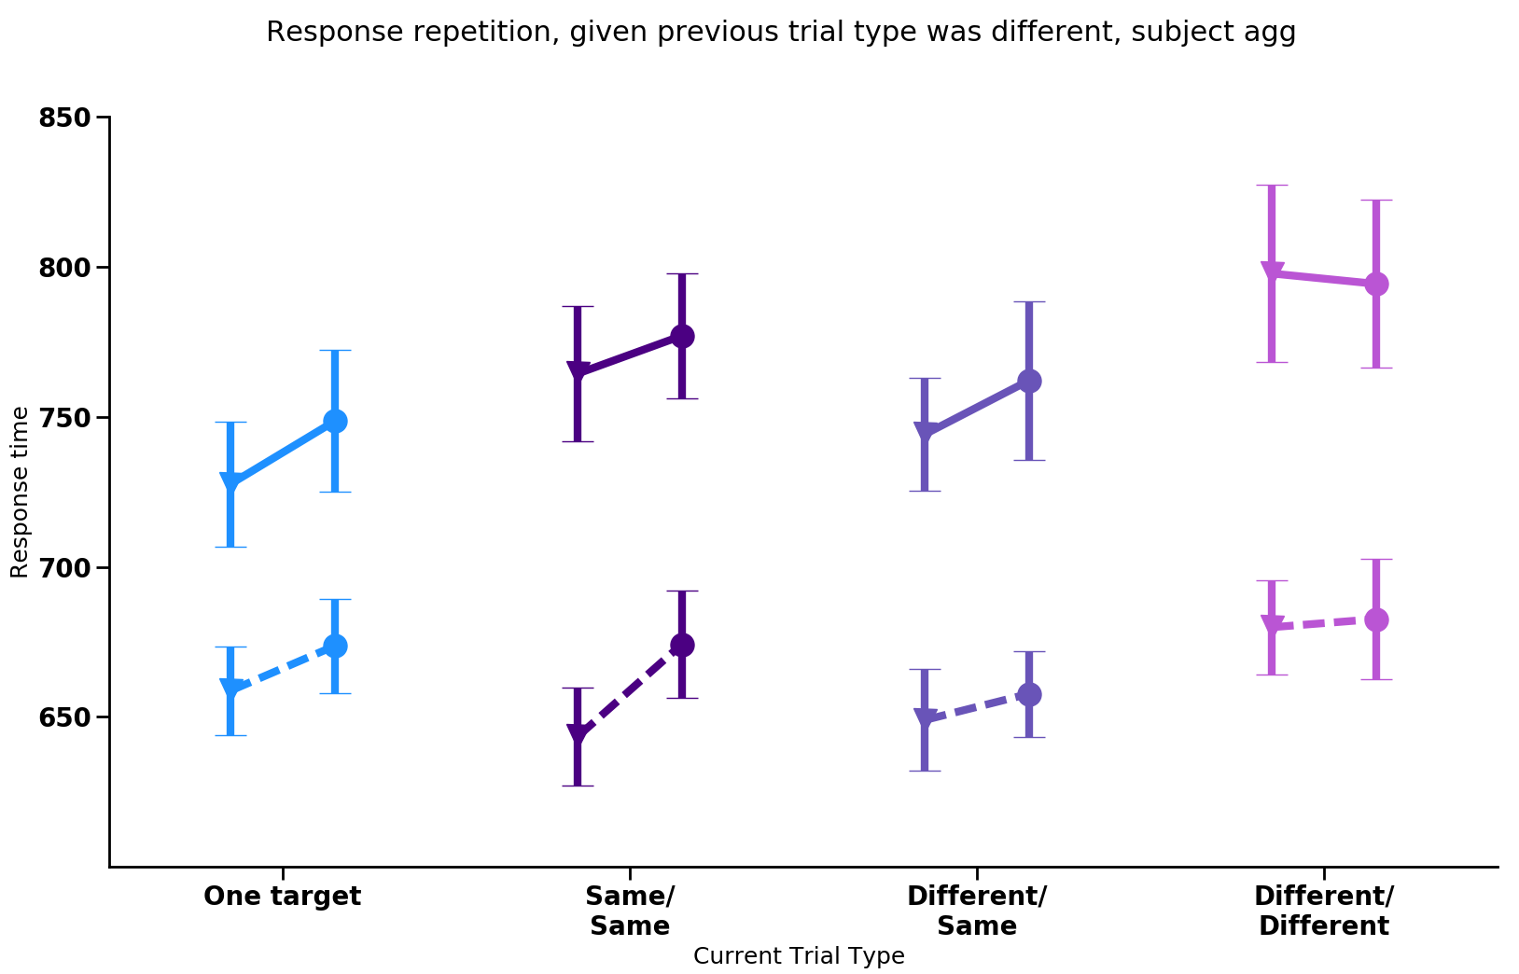
Repeated response
Switched response
Notes:
If simultaneous encoding of response and percept, then when the previous trial type was different (different percept on trial N-1) and response was the same as the current trial (same response on trial N-1) then RT should be longer than when response was different on previous trial (switched response on trial N-1) because of an active representation ‘event file’ (Hommel) that includes the trial N-1 percept and response.

Slide 3
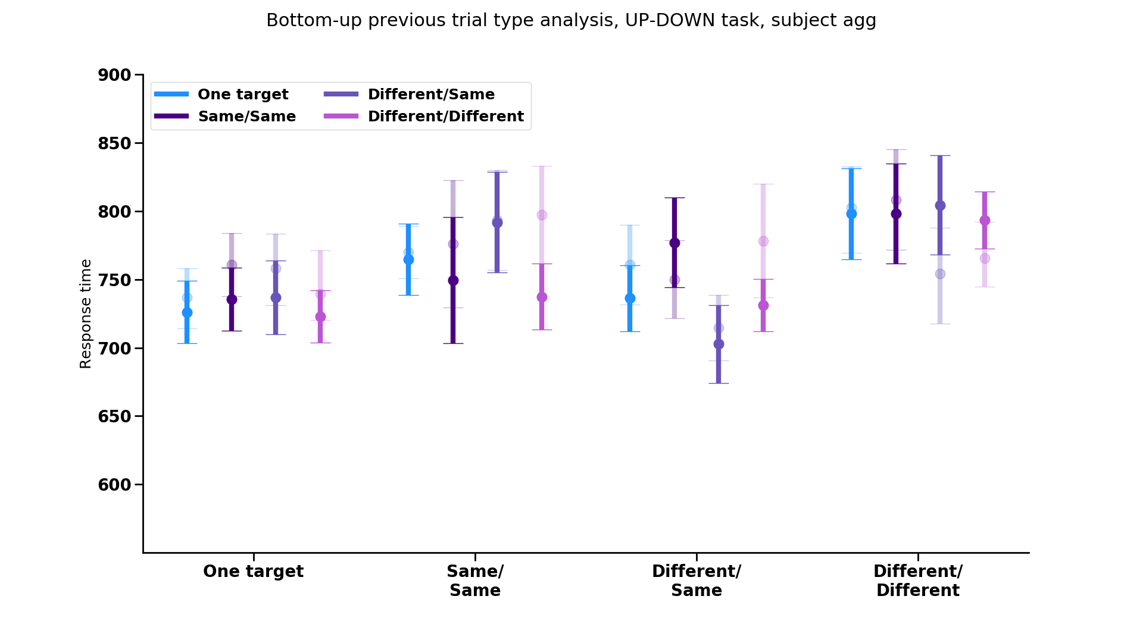
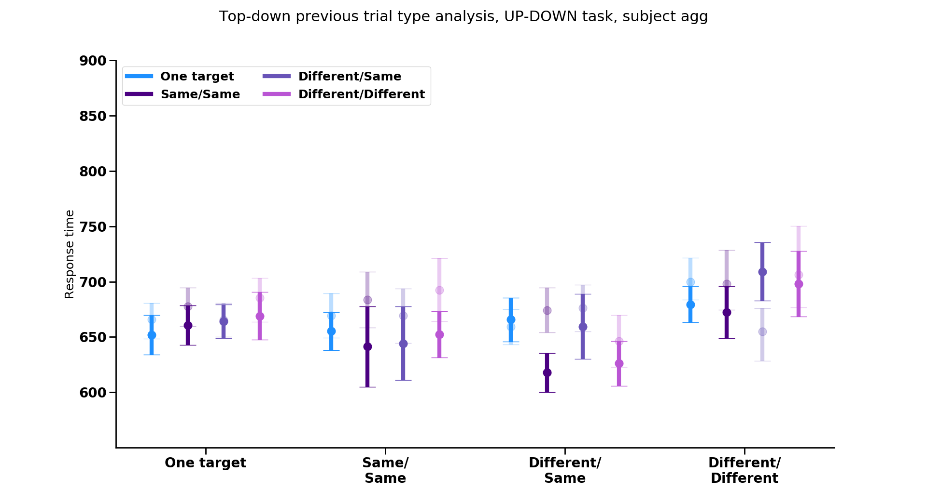
Previous trial type by response repetition
Repeated resp.
Switched resp.
Previous trial
Previous trial
One target
Same/Same
Different/Same
Different/Different
One target
Same/Same
Different/Same
Different/Different
Current trial
Notes:
** SOME PARTICIPANTS DO NOT HAVE ANY TRIALS THAT FIT INTO THESE CATEGORIES (i.e., some participants always answered wrong on the small number of trials [~2-10] and thus don’t have a mean to use here)
Verify bernhard hommel prior coding idea is right, if so what would be the best graph to show it
Think about what to do if not talking about the previous trial stuff

Slide 4
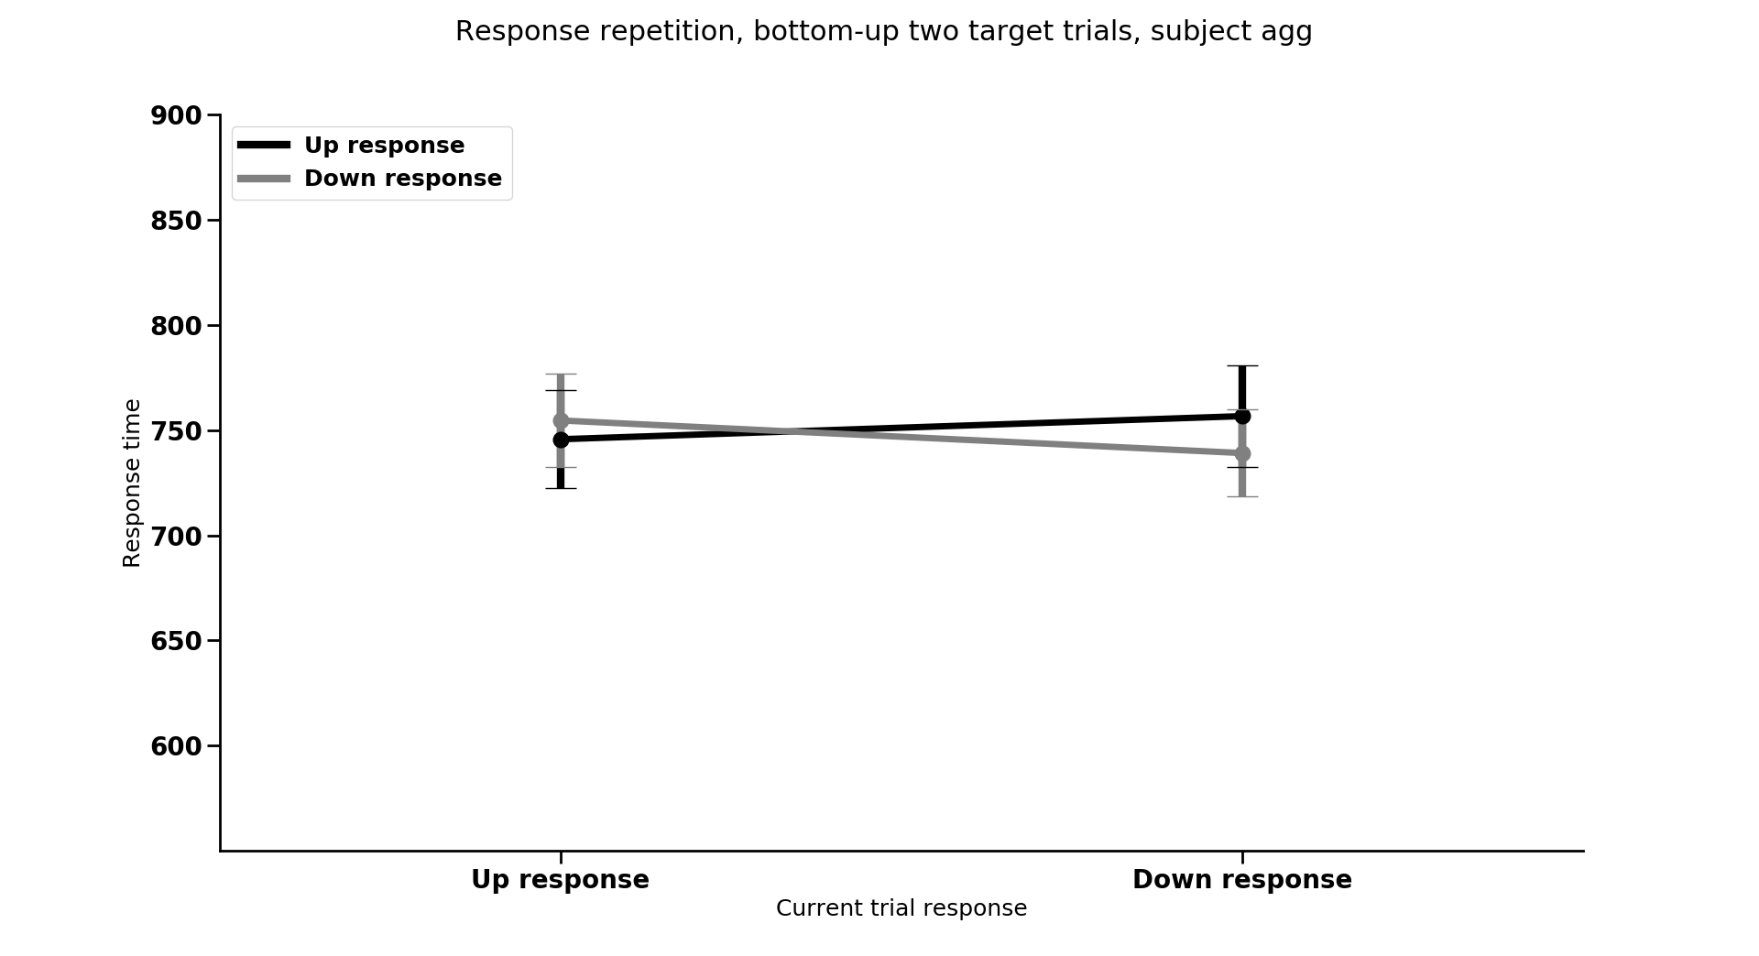
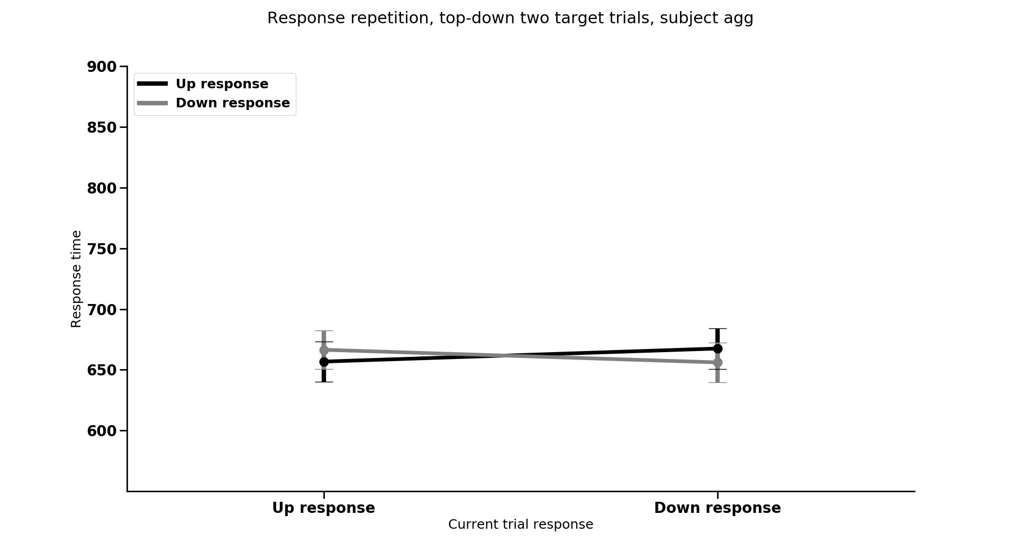
Response repetition
Current response

Slide 5
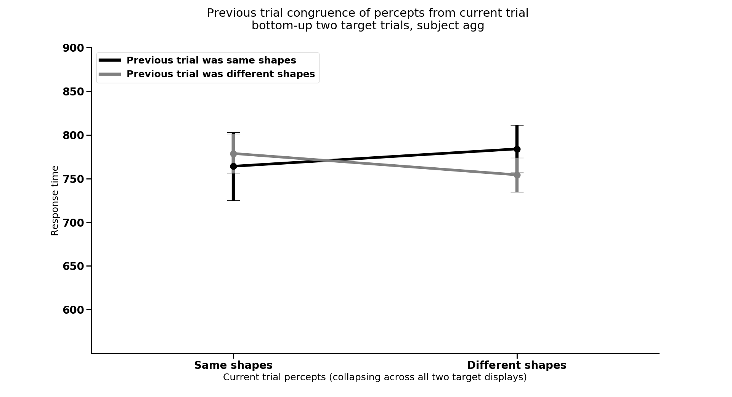
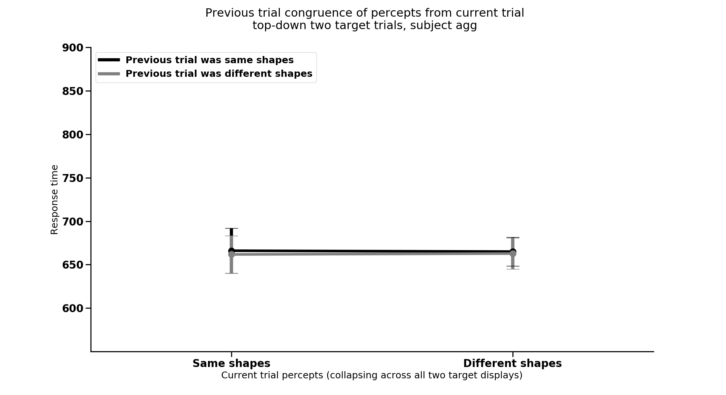
Previous trial type by congruence of shape compatibility,
collapsing across each specific trial type
Current trial shape compatibility
Notes:
2. Gratton effect analysis (switching between congruent previous vs. incongruent previous trial) sequence effects

Slide 6
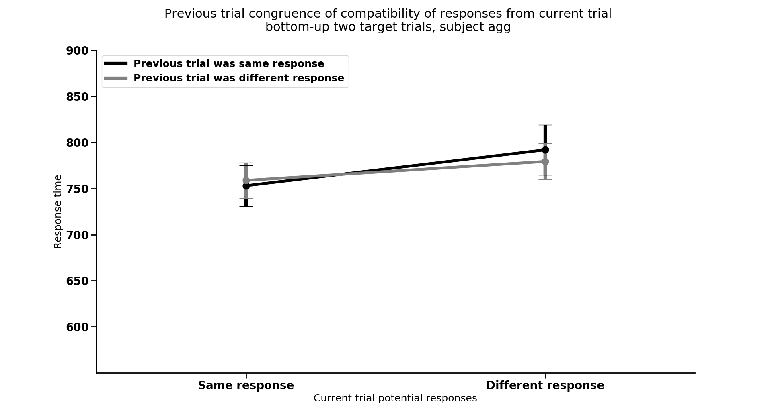
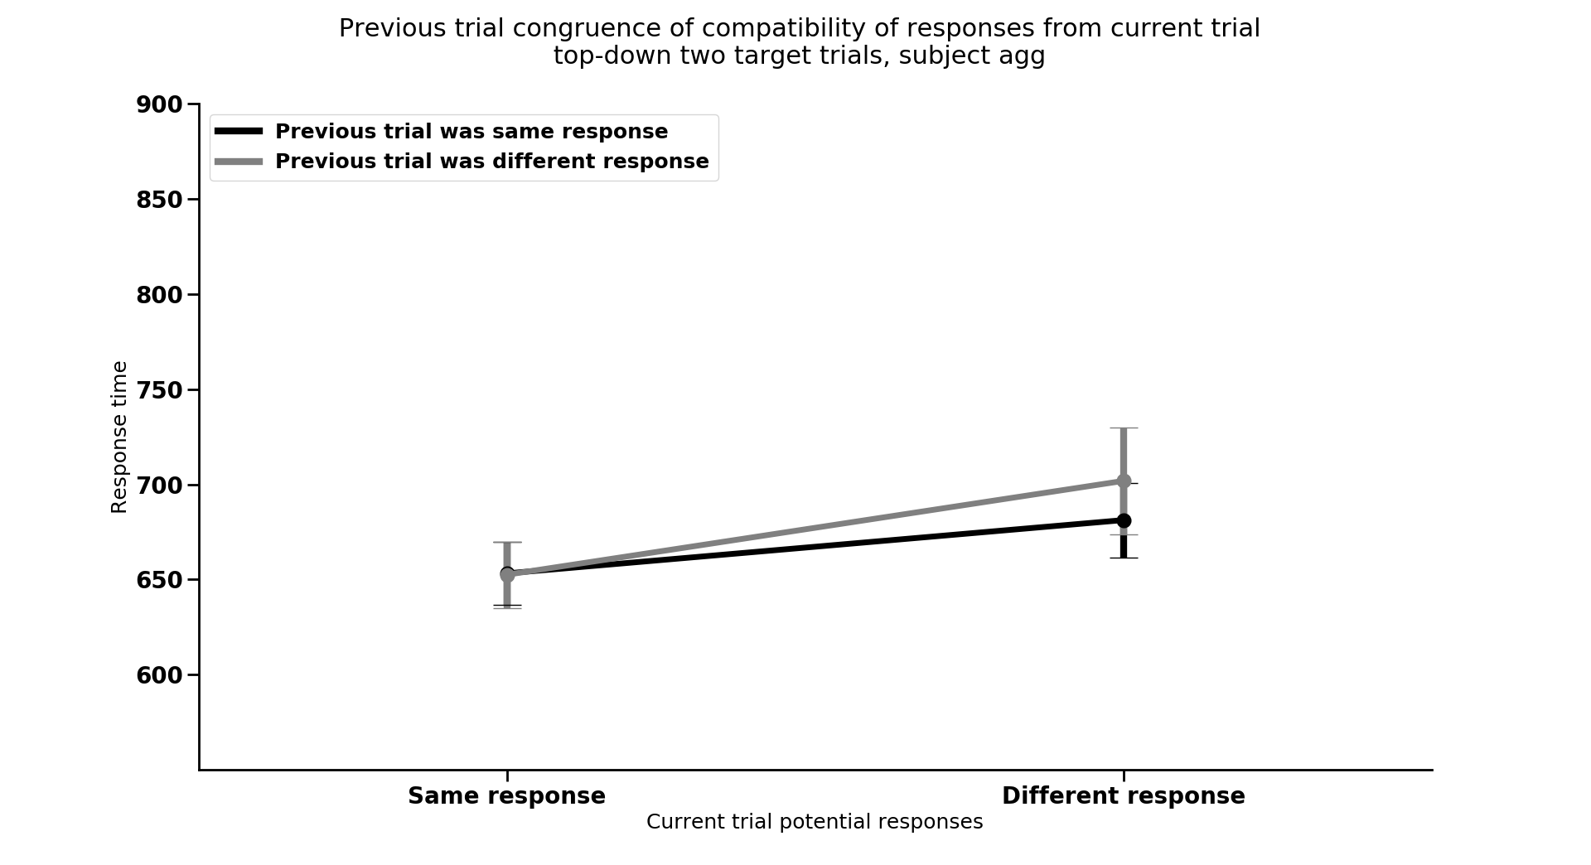
Previous trial type by congruence of response compatibility,
collapsing across each specific trial type
Current trial response compatibility
Notes:
2. Gratton effect analysis (switching between congruent previous vs. incongruent previous trial) sequence effects

Slide 7
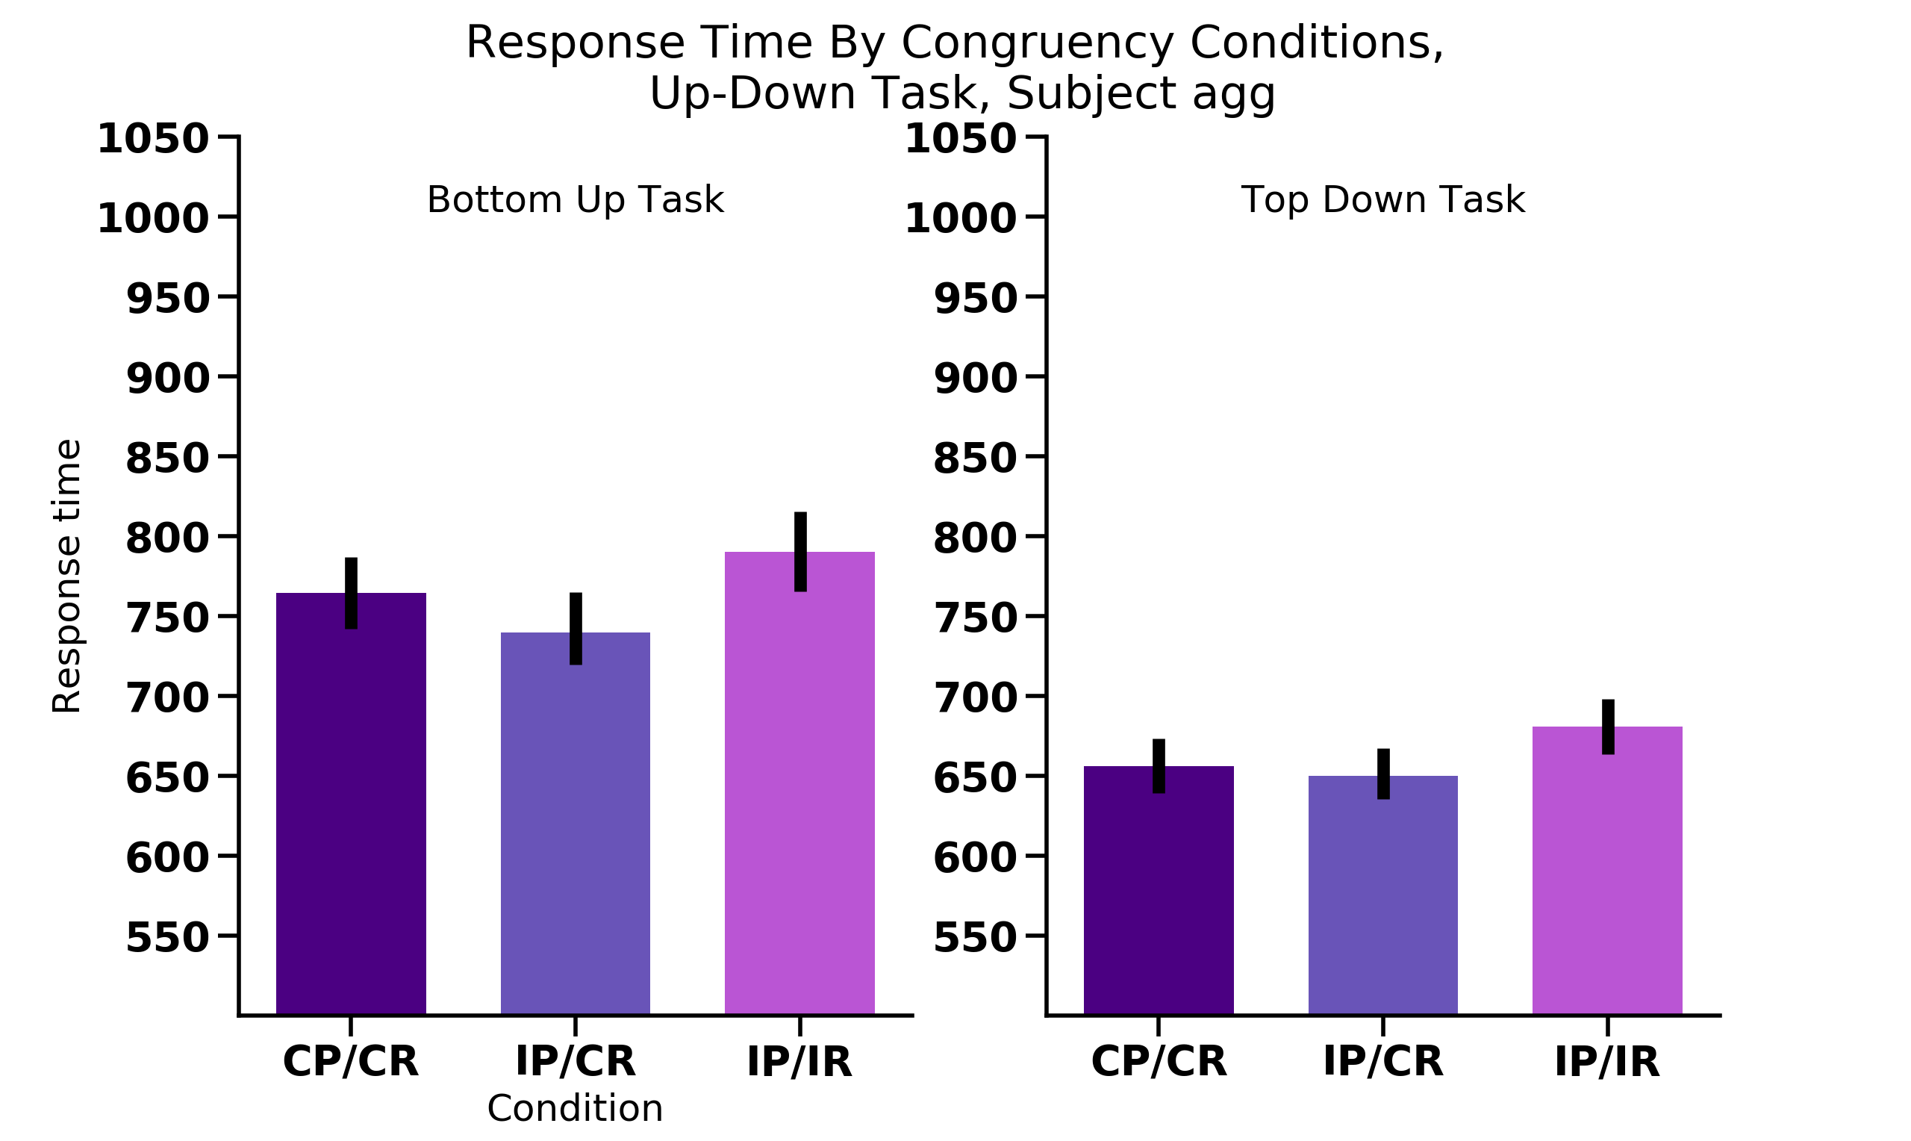
Percept
Response
UP
UP
UP
UP
UP
DOWN
UP
UP
UP
UP
UP
DOWN
N = 18

Slide 8
Previous trial type by response repetition
Repeated resp.
Switched resp.
Previous trial
Previous trial
One target
Same/Same
Different/Same
Different/Different
One target
Same/Same
Different/Same
Different/Different
Current trial
Notes:
** SOME PARTICIPANTS DO NOT HAVE ANY TRIALS THAT FIT INTO THESE CATEGORIES (i.e., some participants always answered wrong on the small number of trials [~2-10] and thus don’t have a mean to use here)
Verify bernhard hommel prior coding idea is right, if so what would be the best graph to show it
Think about what to do if not talking about the previous trial stuff

Slide 9
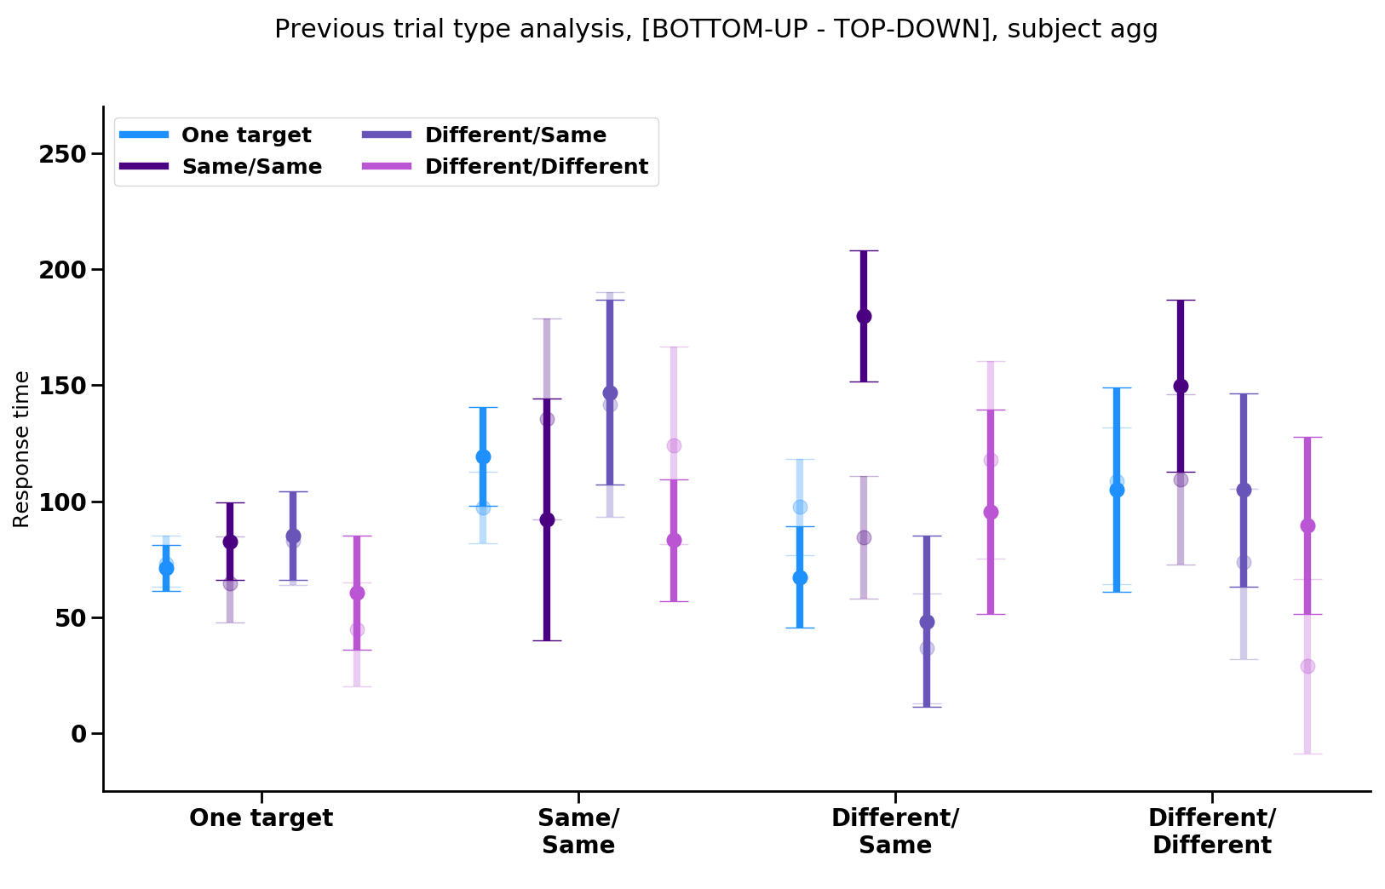
Previous trial
Repeated resp.
Switched resp.
One target
Same/Same
Different/Same
Different/Different
Current trial
Notes:
** SOME PARTICIPANTS DO NOT HAVE ANY TRIALS THAT FIT INTO THESE CATEGORIES (i.e., some participants always answered wrong on the small number of trials [~2-10] and thus don’t have a mean to use here)
This is the mean difference between BU rt and TD rt for each subject for each condition, with BS SEMS of the mean differences
Idea is to see what exists in the bottom-up data that isn’t in the top-down data by subtracting the top-down as if it were baseline

Slide 10
Previous trial type analysis, Exps. 1-2

Slide 11
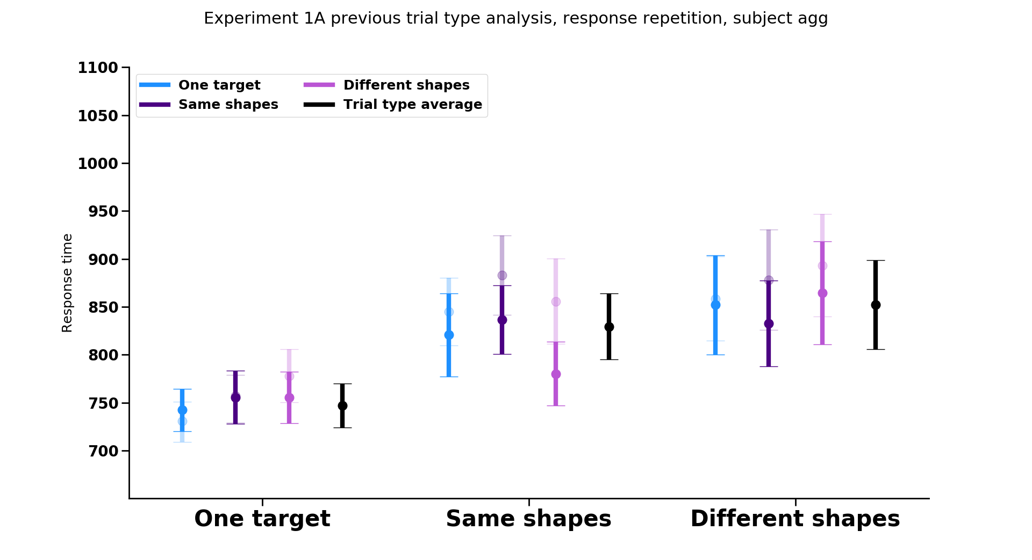
Previous trial
Repeated resp.
Switched resp.
Current trial

Slide 12
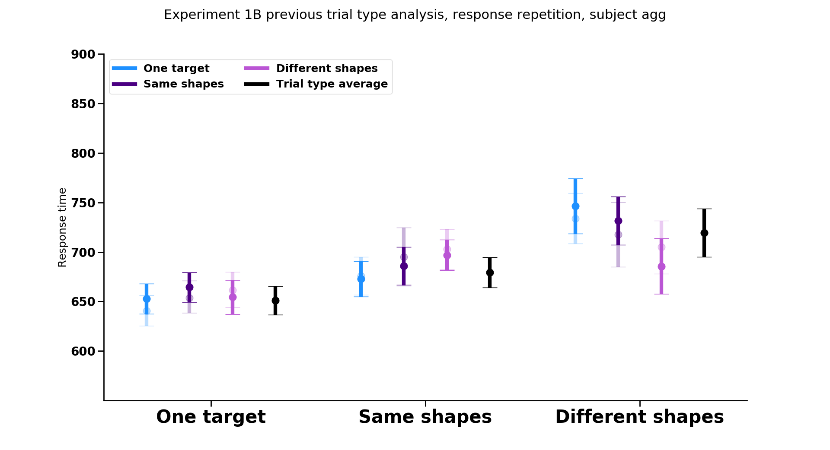
Previous trial
Repeated resp.
Switched resp.
Current trial

Slide 13
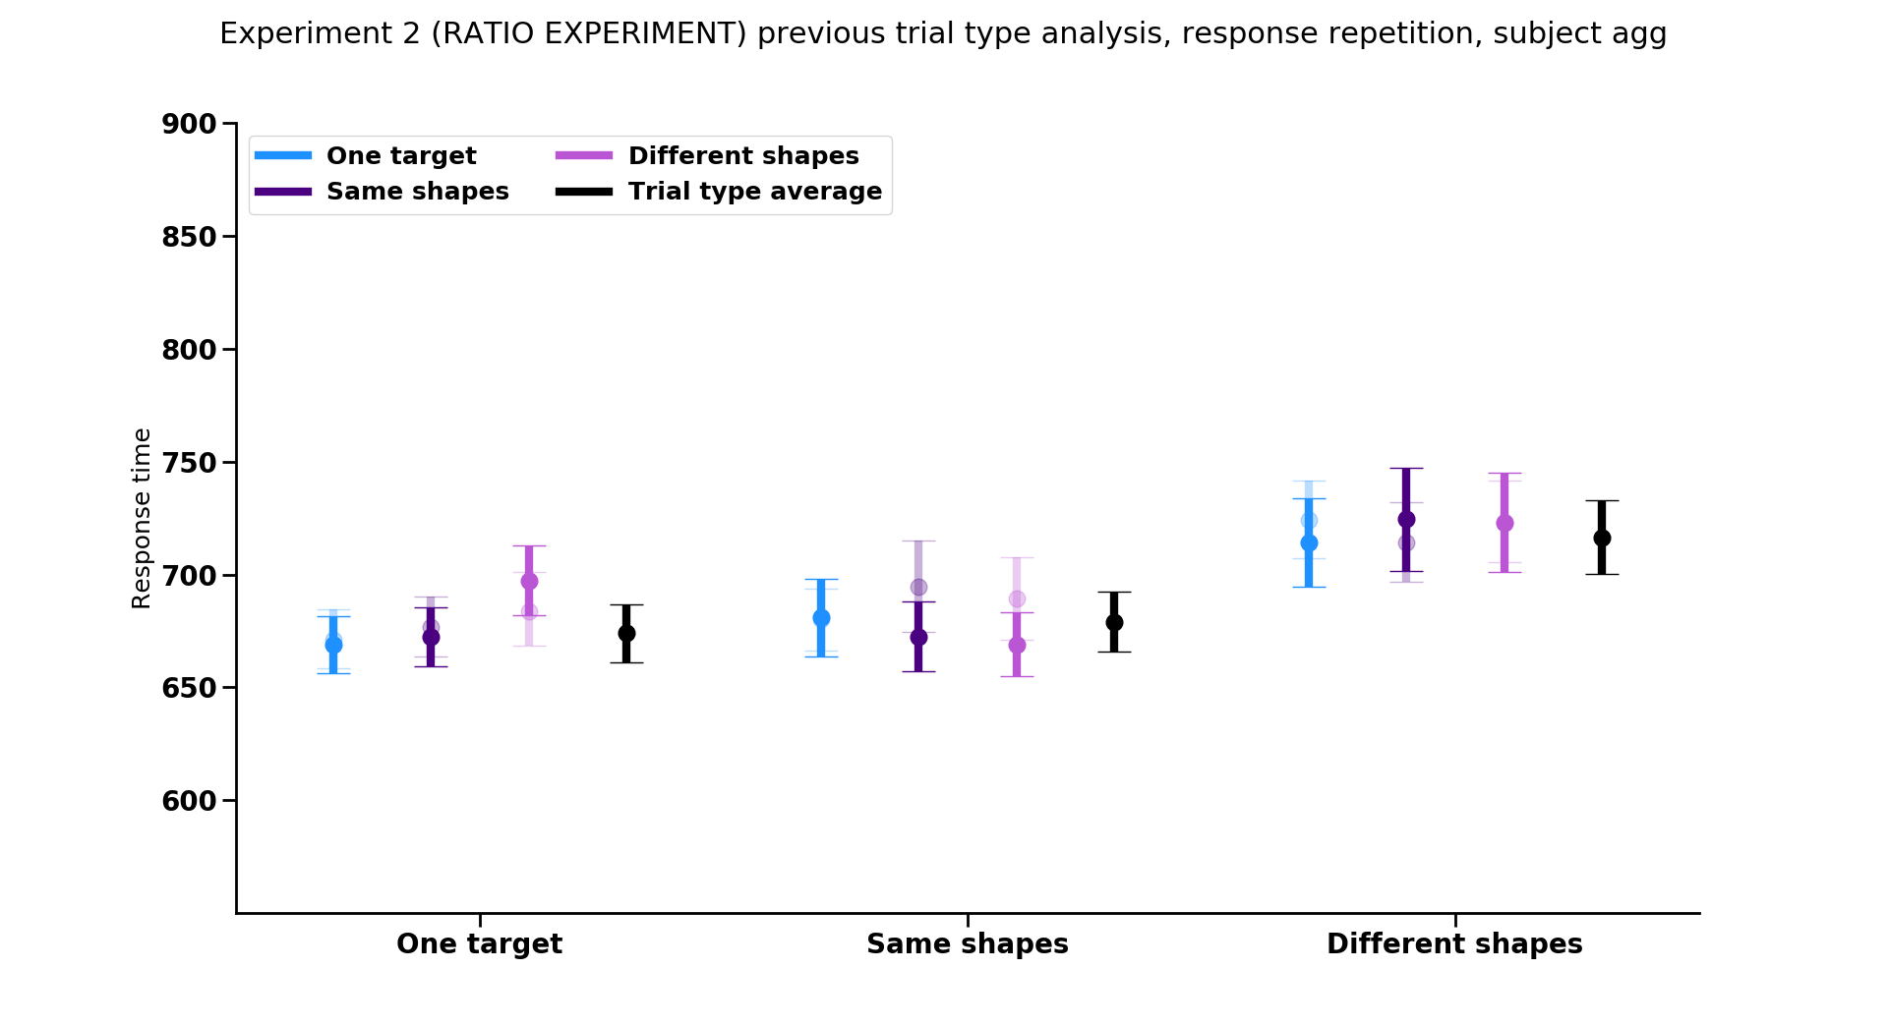
Previous trial
Repeated resp.
Switched resp.
Current trial

Slide 14
Repeated resp.
Switched resp.
Notes:
Trend: response repetition matters when the current trial has same responses (in exps 1A and 2)

Slide 15
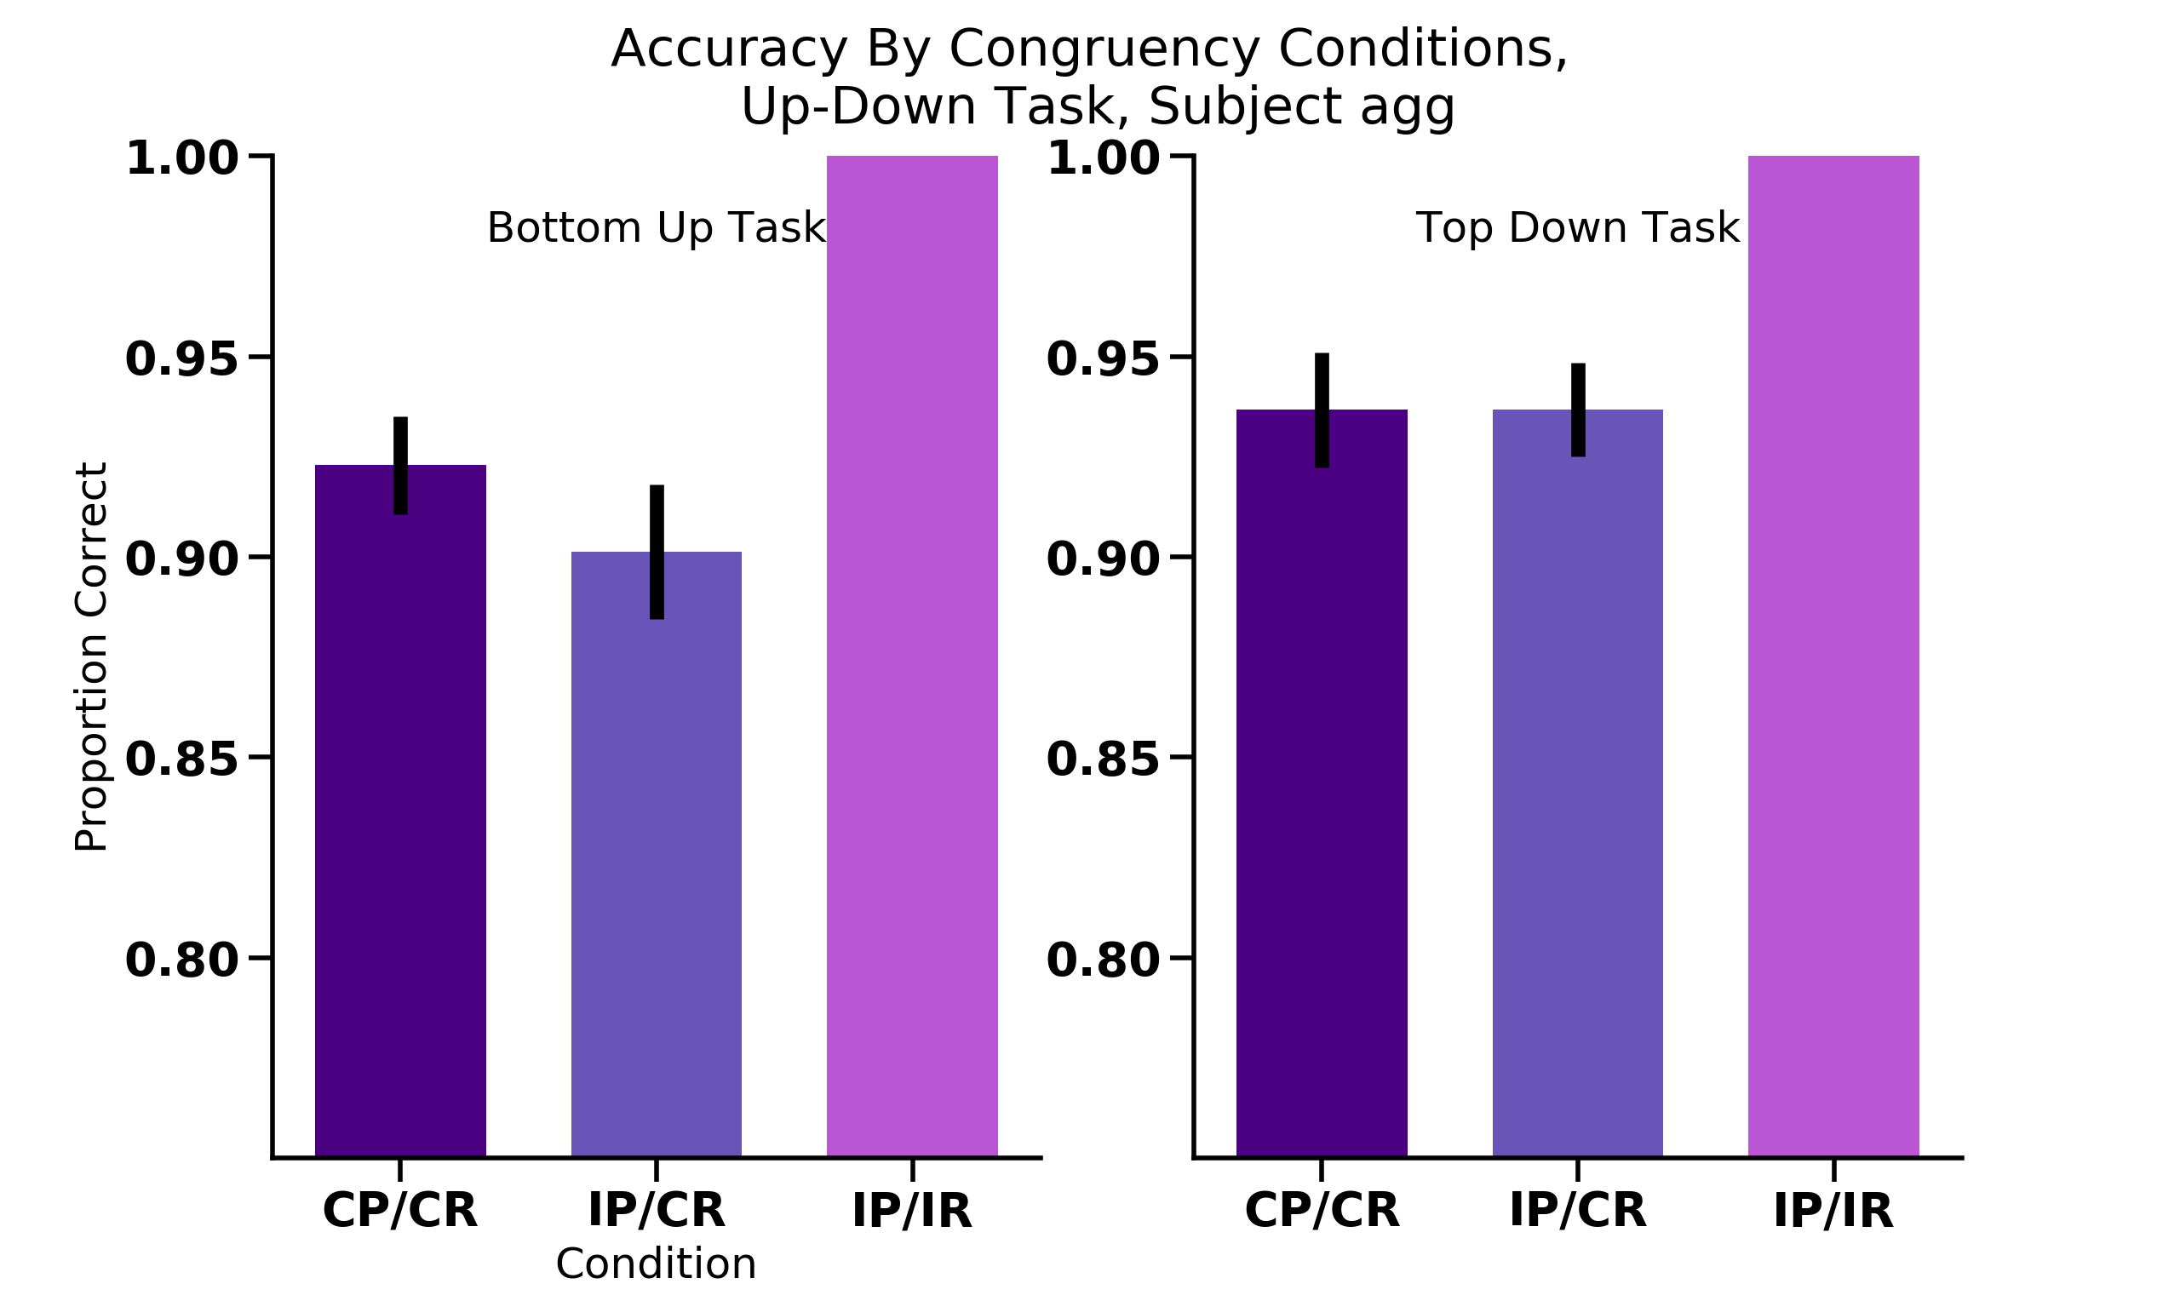
UP
UP
UP
UP
UP
DOWN
UP
UP
UP
UP
UP
DOWN
UP
UP
UP
UP
UP
DOWN
UP
UP
UP
UP
UP
DOWN

Slide 16
Percept
Response
UP
UP
UP
UP
UP
DOWN
UP
UP
UP
UP
UP
DOWN
N = 18

Slide 17
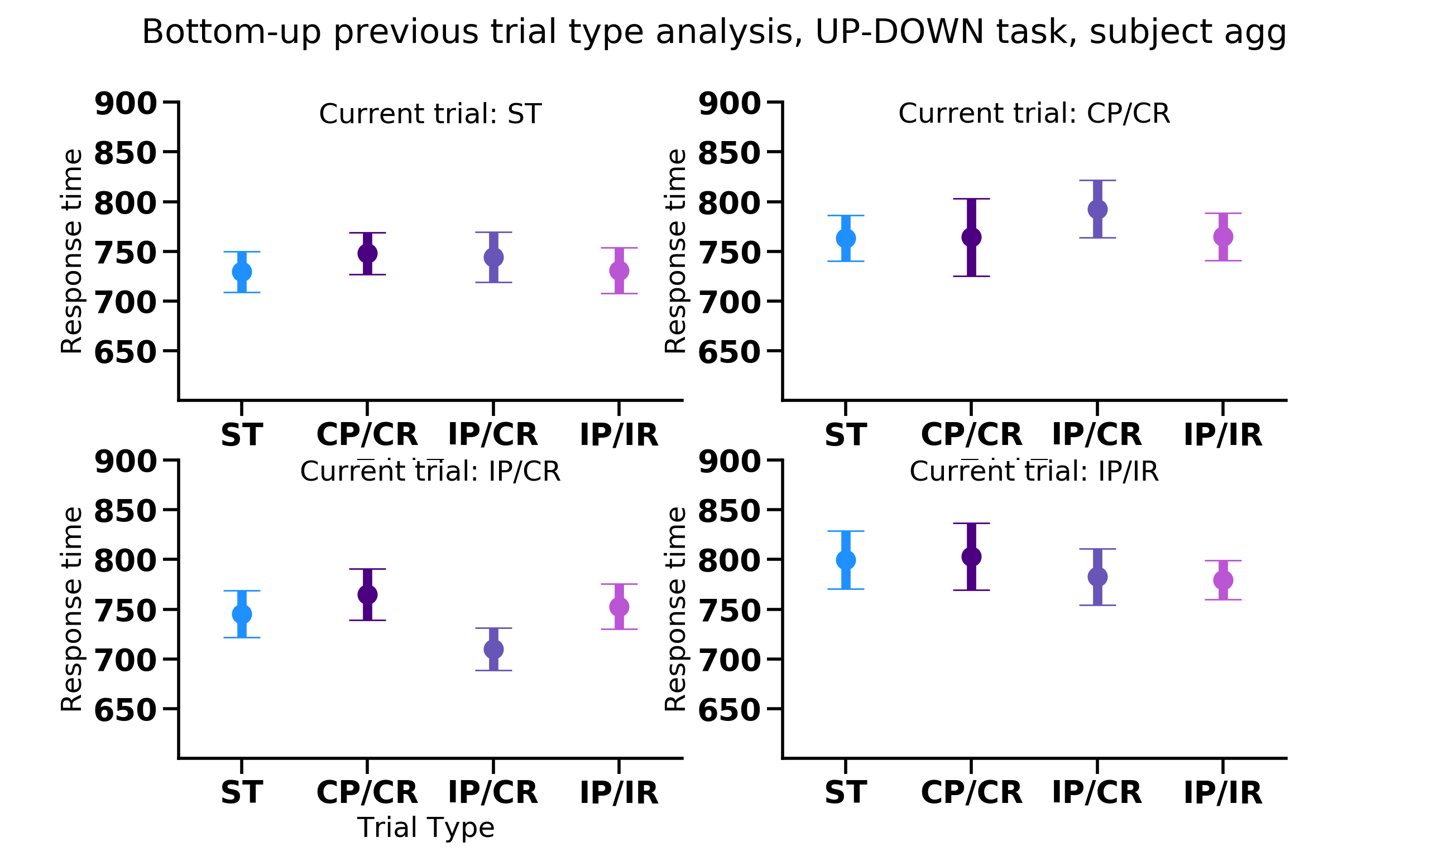
Previous trial type
Notes:
Stats
Plots:
Plot cong cong and incong/cong together on the same figure
Also plot with the xaxsi the same and put all three 2 trial types on same plot to see if there are main effects there (for each type of 2 target trial)
Better way to convey the material here??? Not x axis stuff here
Analysis:
1. check accoridng to whetehr response itself was repeated ornot repeated for each type of two target trial (collapsing across all 2 target trial types, and with the 1 target trial type )
2. Gratton (Grafton?) effect analysis (switching between congruent previous vs. incongruent previous trial) sequence effects
3. Separate out the response trials wrt to whether the same response or diff response (e.g., cong/cong trials, whether same response as this trial or different response)
Bernhard Hommel (shared representations) BBS paper- theory of event coding

Slide 18
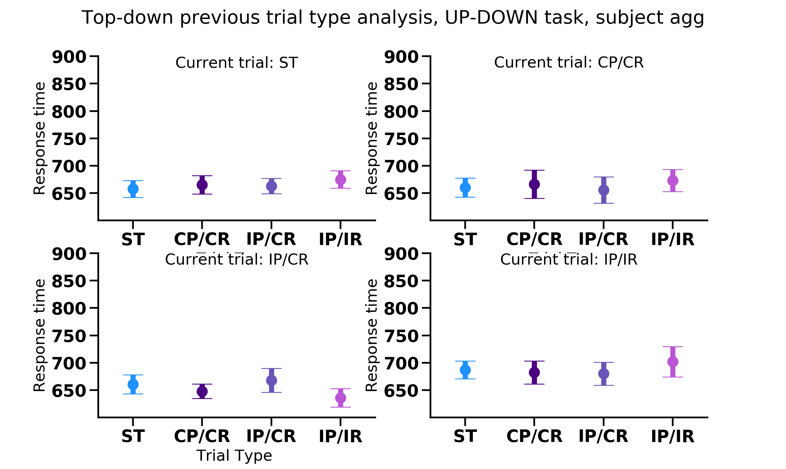
Previous trial type

Slide 19
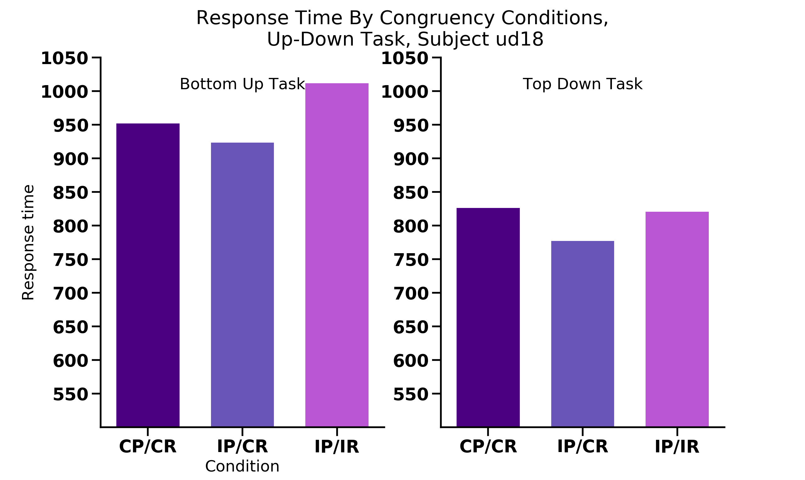
Percept
Response
UP
UP
UP
UP
UP
DOWN
UP
UP
UP
UP
UP
DOWN

Slide 20
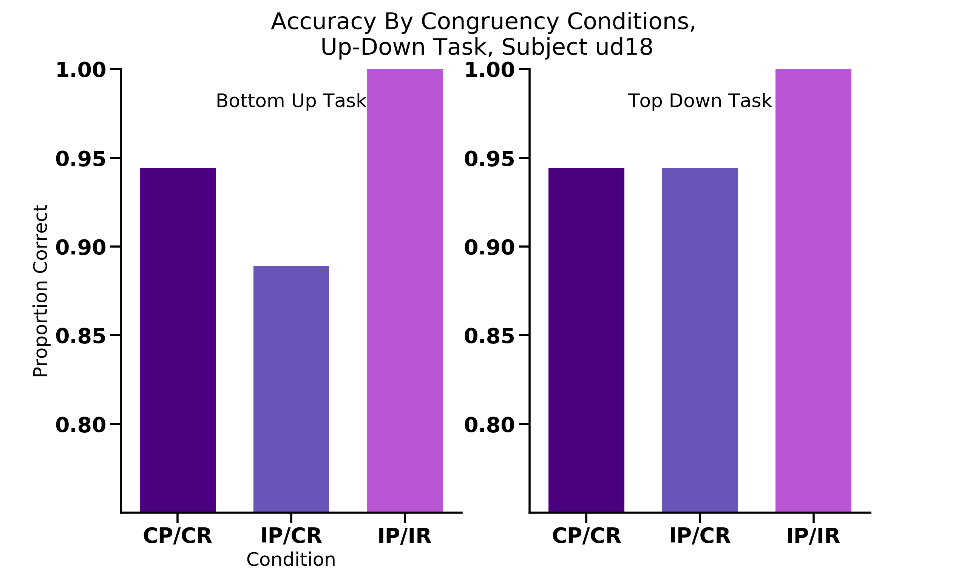
Percept
Response
UP
UP
UP
UP
UP
DOWN
UP
UP
UP
UP
UP
DOWN

Slide 21
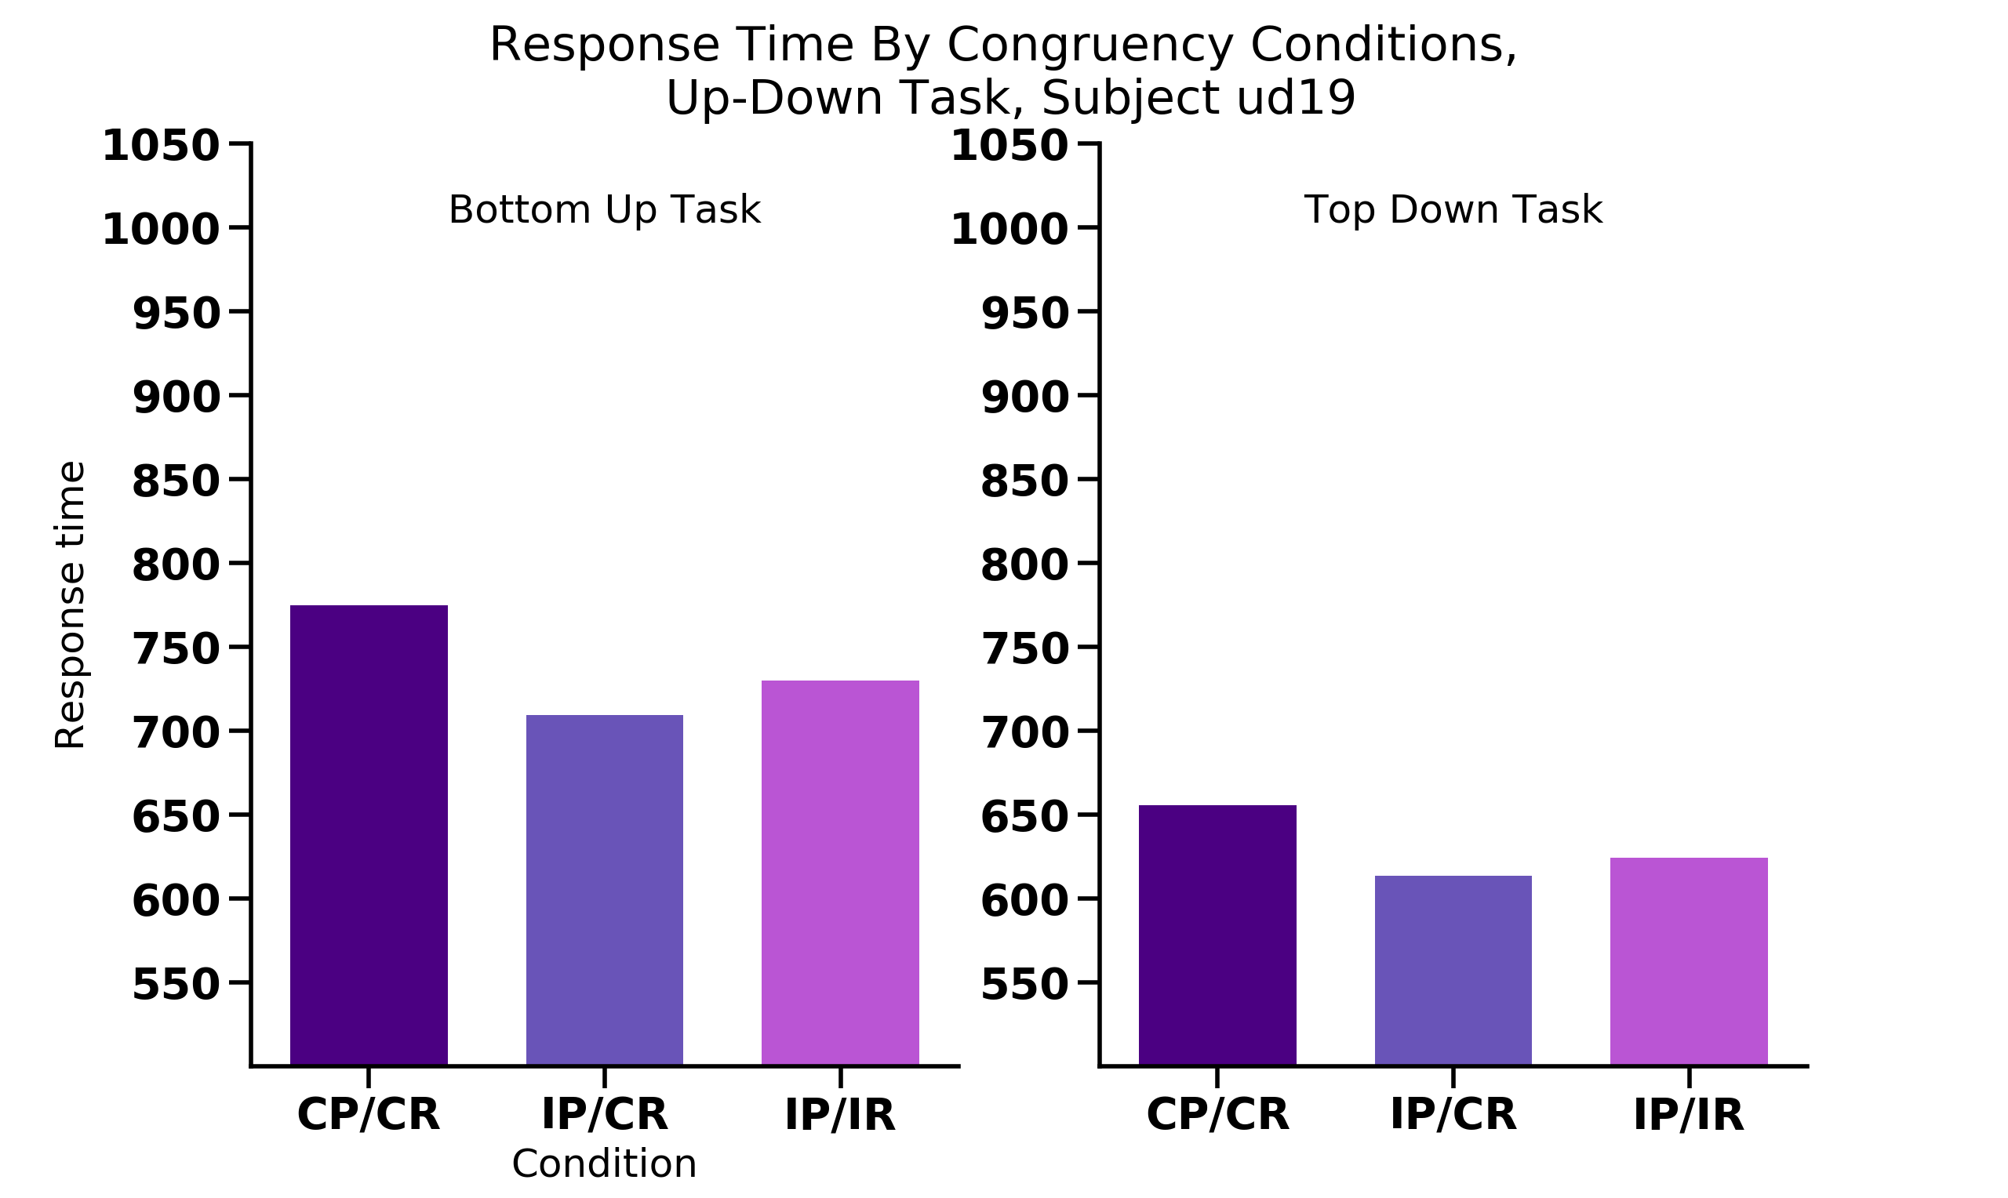
Percept
Response
UP
UP
UP
UP
UP
DOWN
UP
UP
UP
UP
UP
DOWN

Slide 22
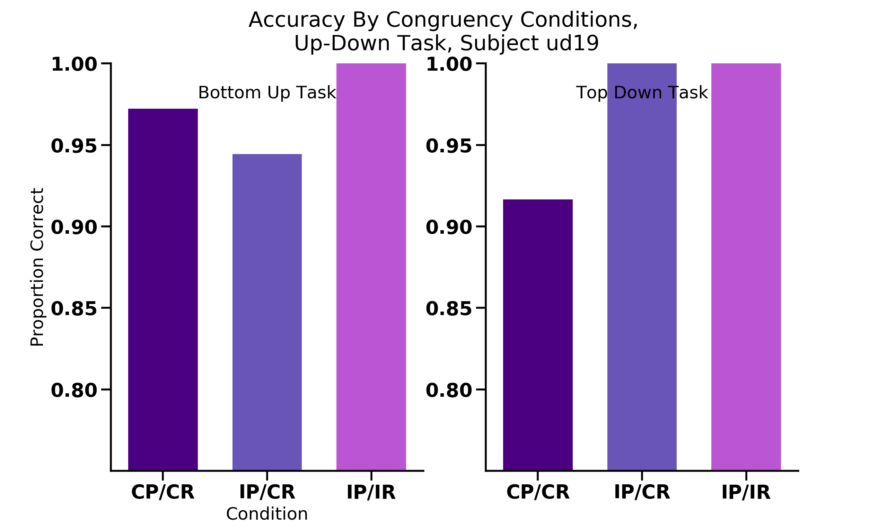
Percept
Response
UP
UP
UP
UP
UP
DOWN
UP
UP
UP
UP
UP
DOWN

Slide 23
16 participants
Congruent/Congruent = NOT FASTEST condition

Slide 24
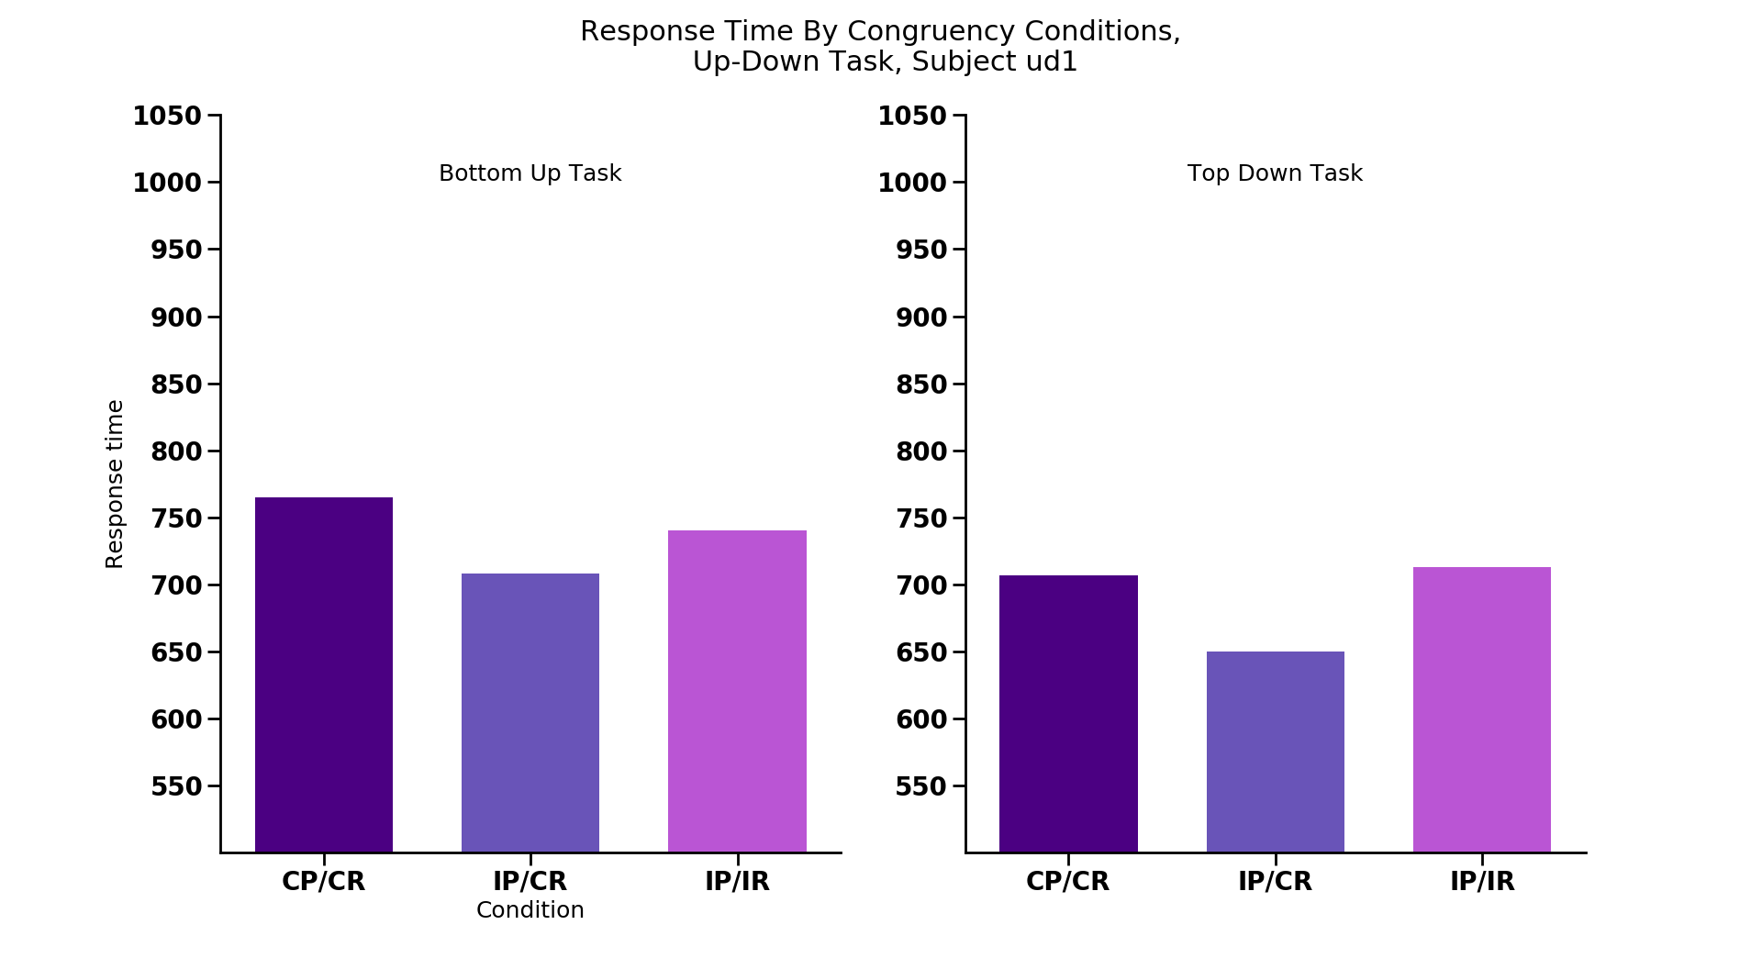
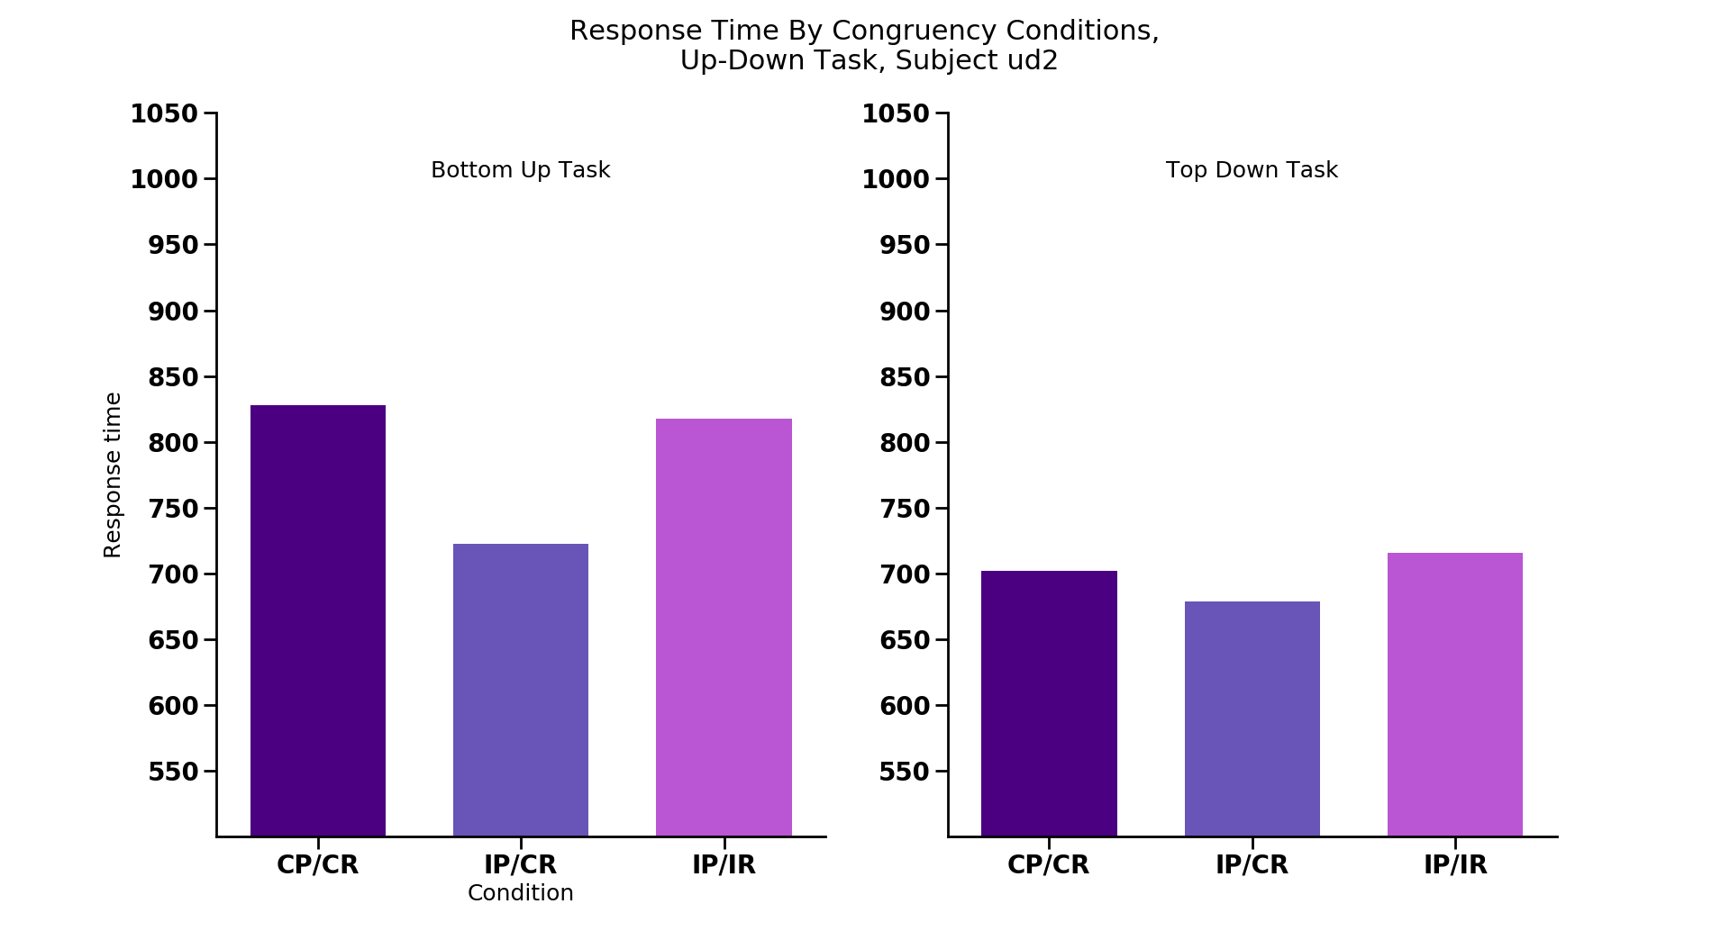
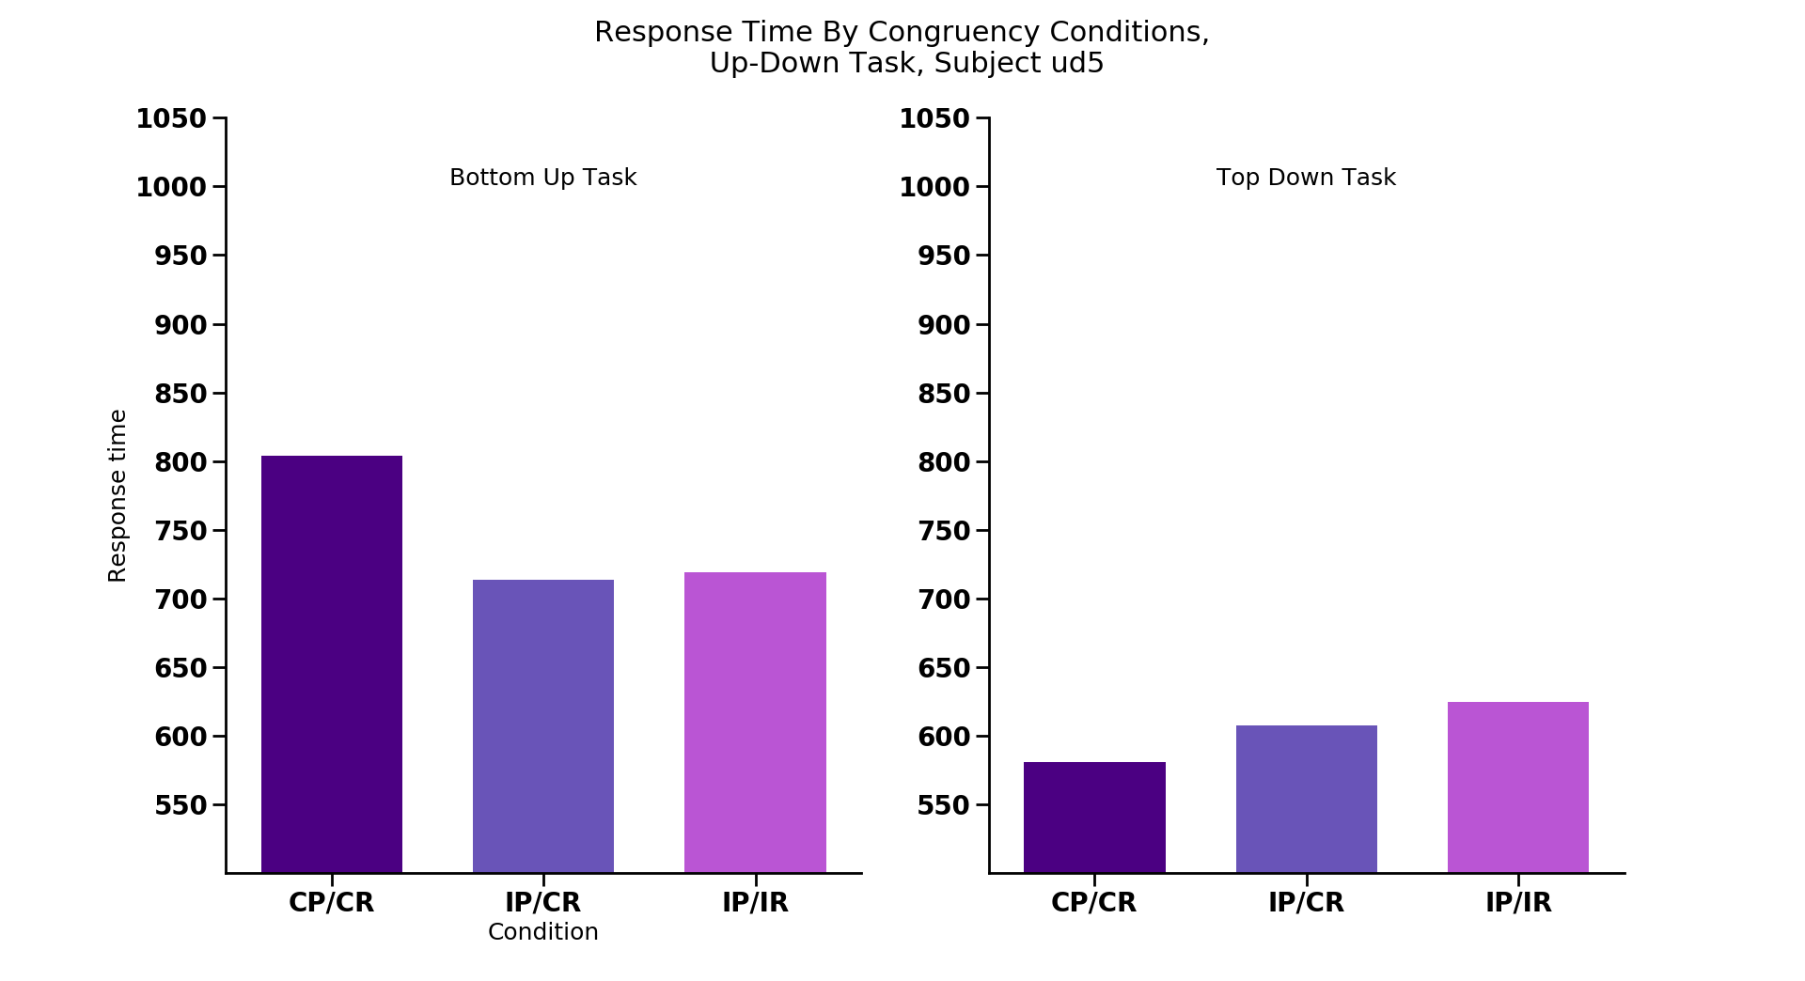
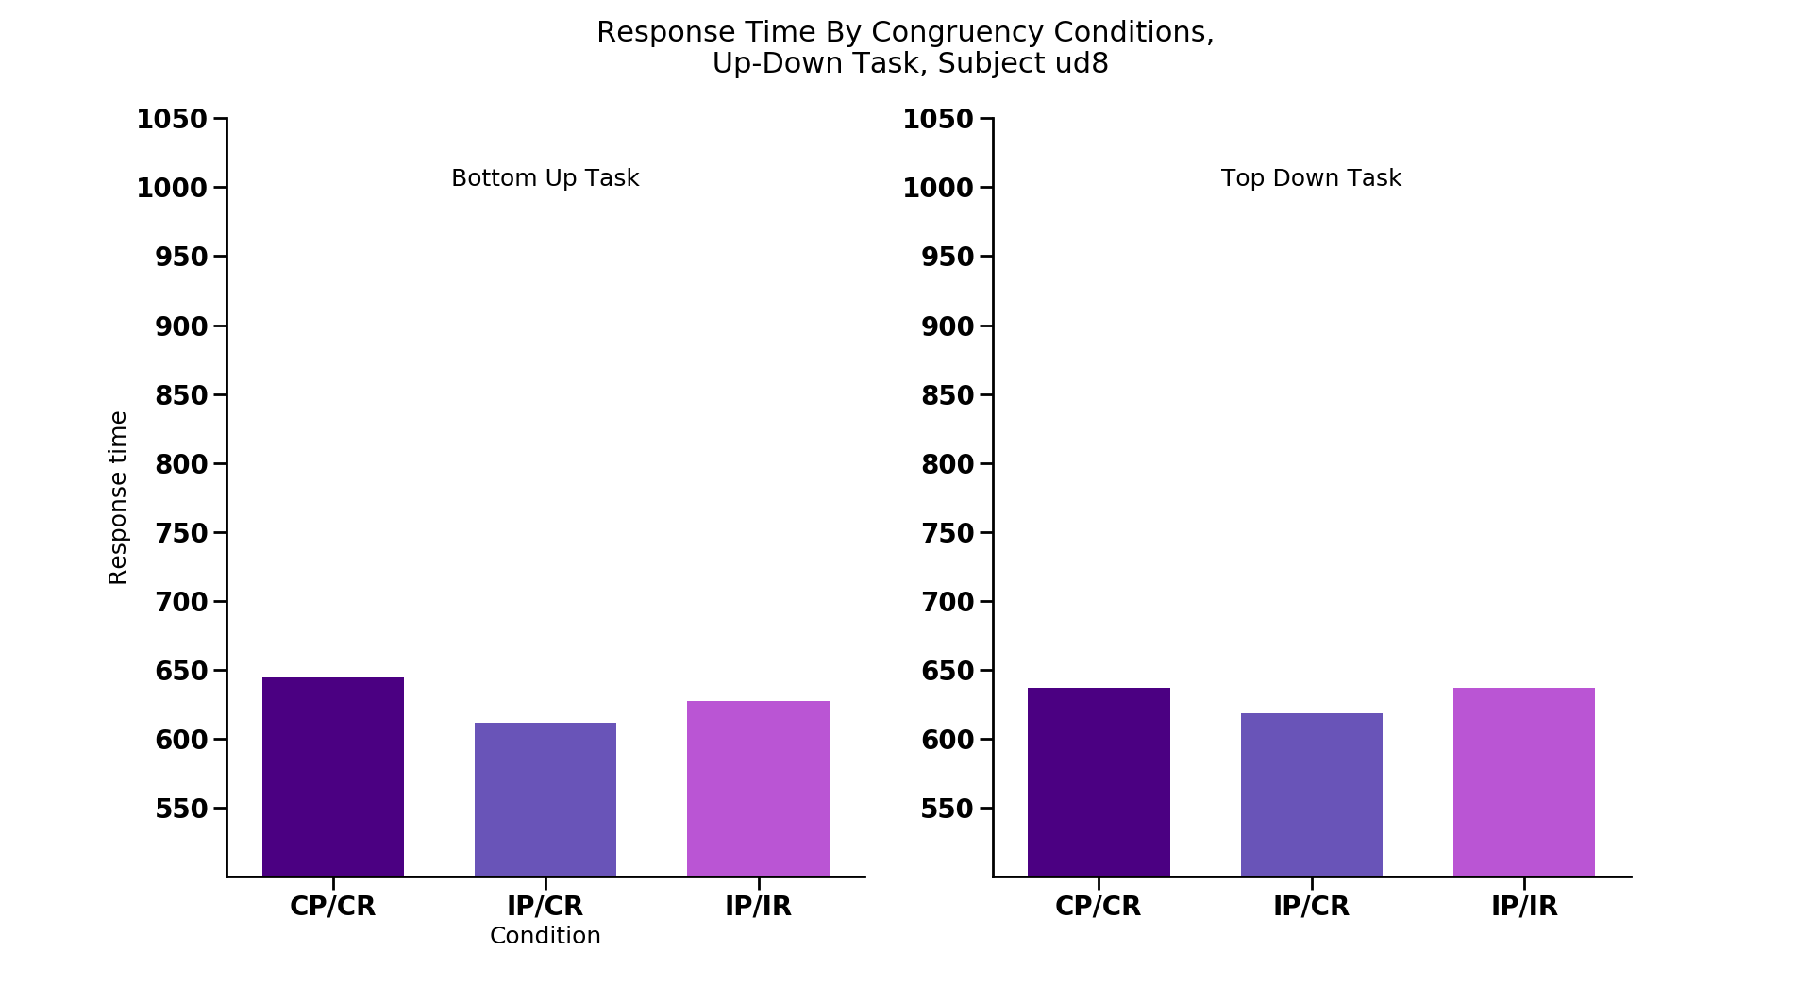
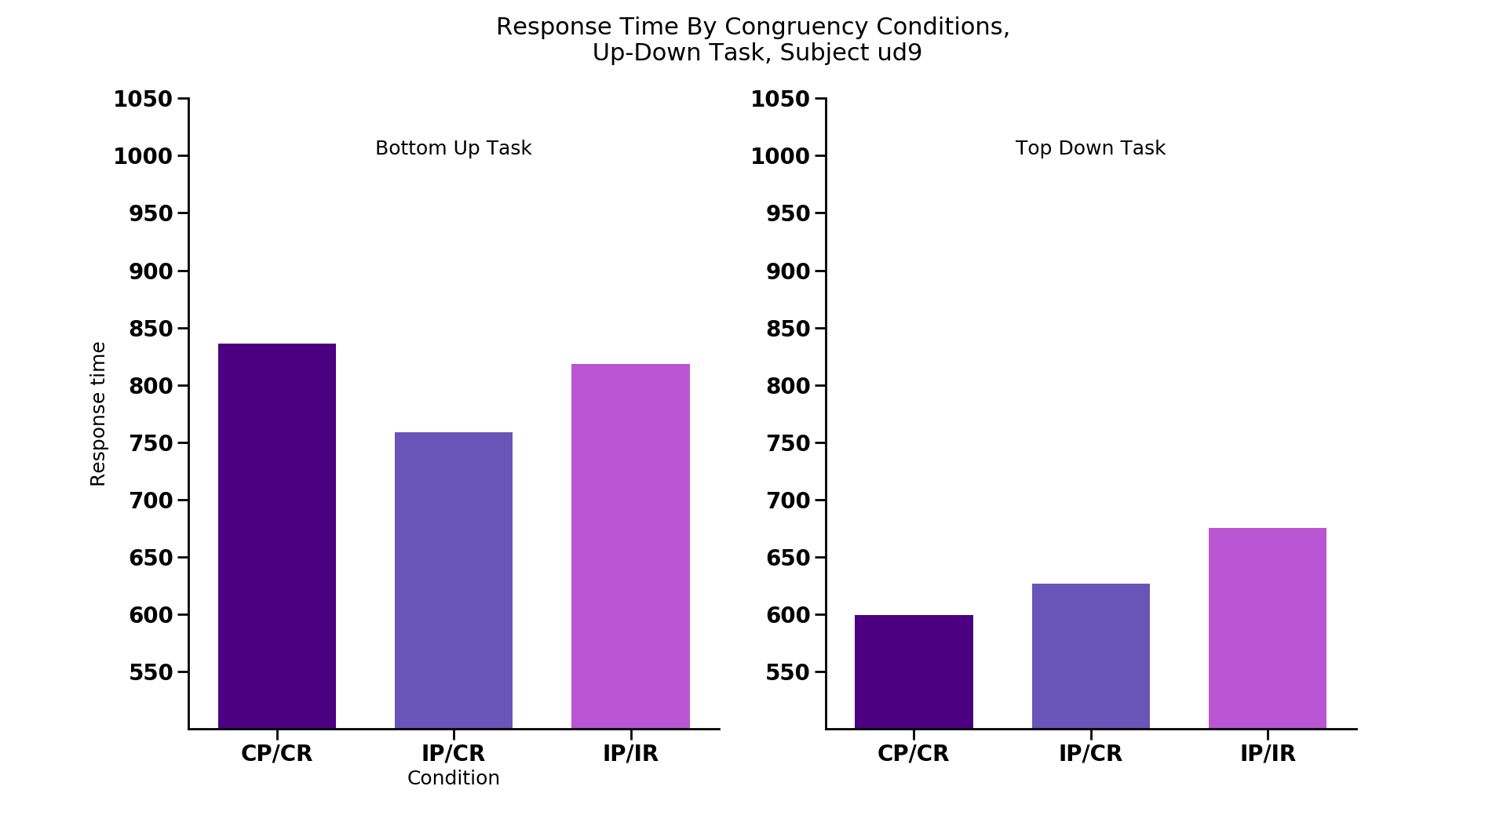
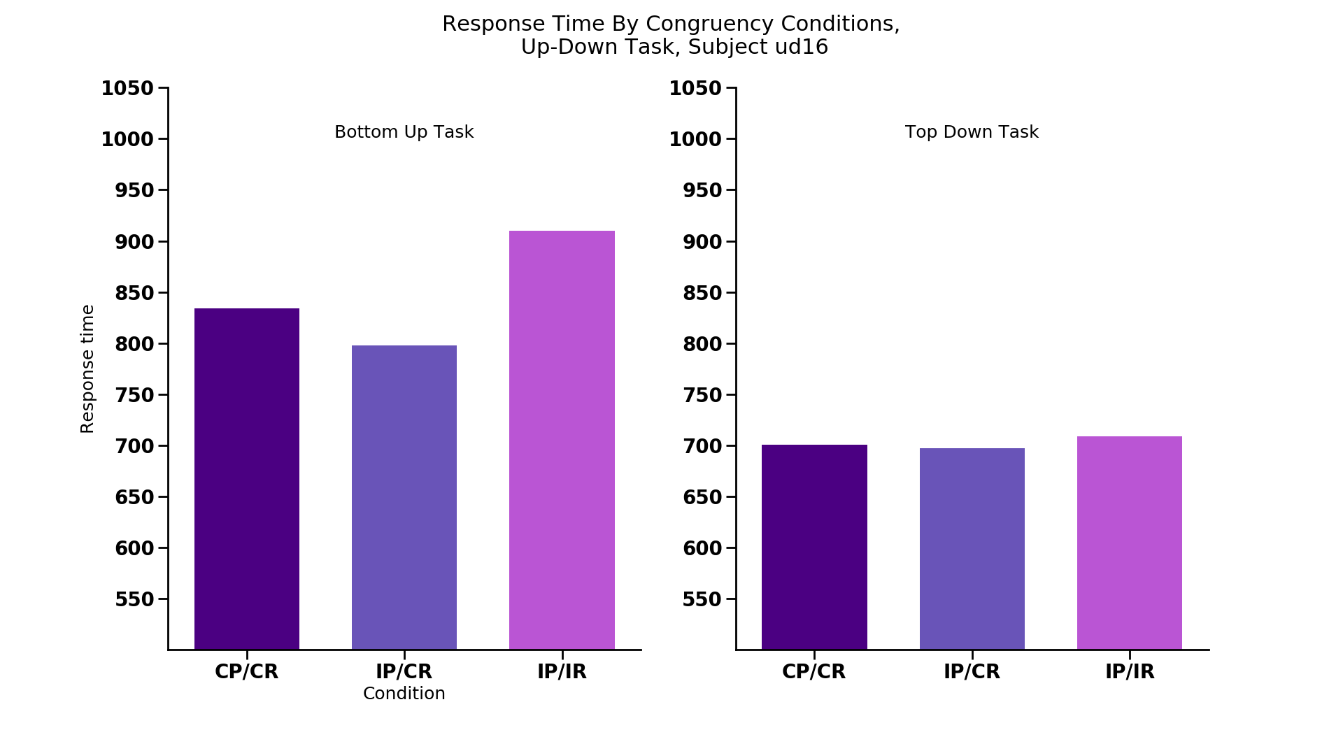
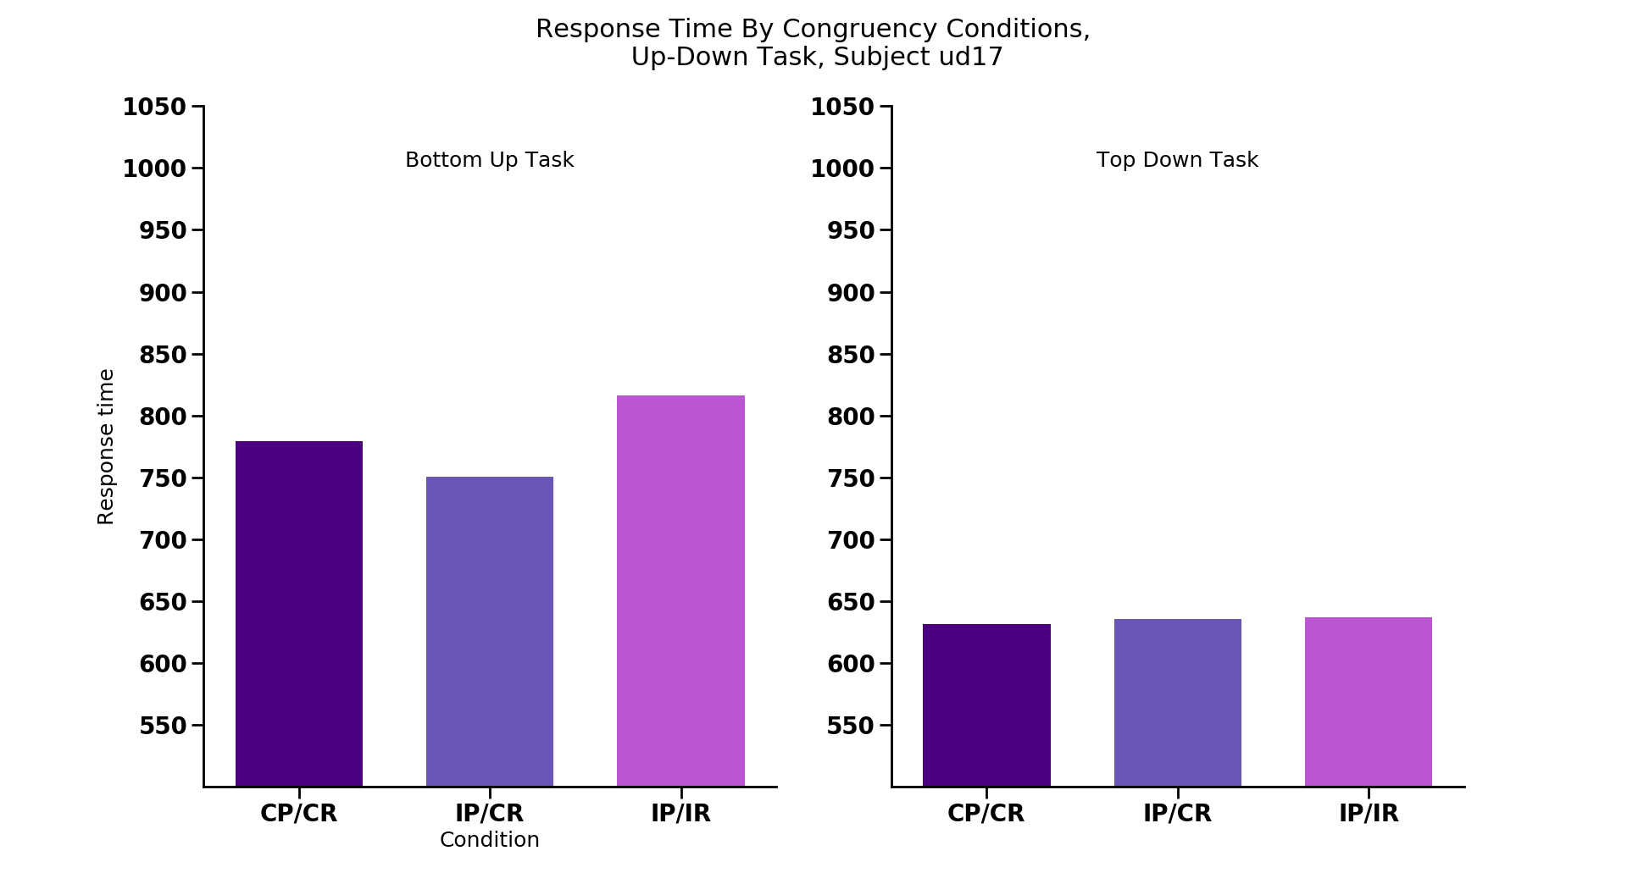
*
*
*
*
CC
IC
II
CC
IC
II
CC
IC
II
CC
IC
II
CC
IC
II
CC
IC
II
CC
IC
II
CC
IC
II
*
CC
IC
II
CC
IC
II
CC
IC
II
CC
IC
II
CC
IC
II
CC
IC
II
Notes:
NON-REPLICATING SUBJECTS: each congruency condition
Ud1 (also TD), ud2 (also for TD, small), ud5 (large), ud8, ud9 (large), ud16, ud17

Slide 25
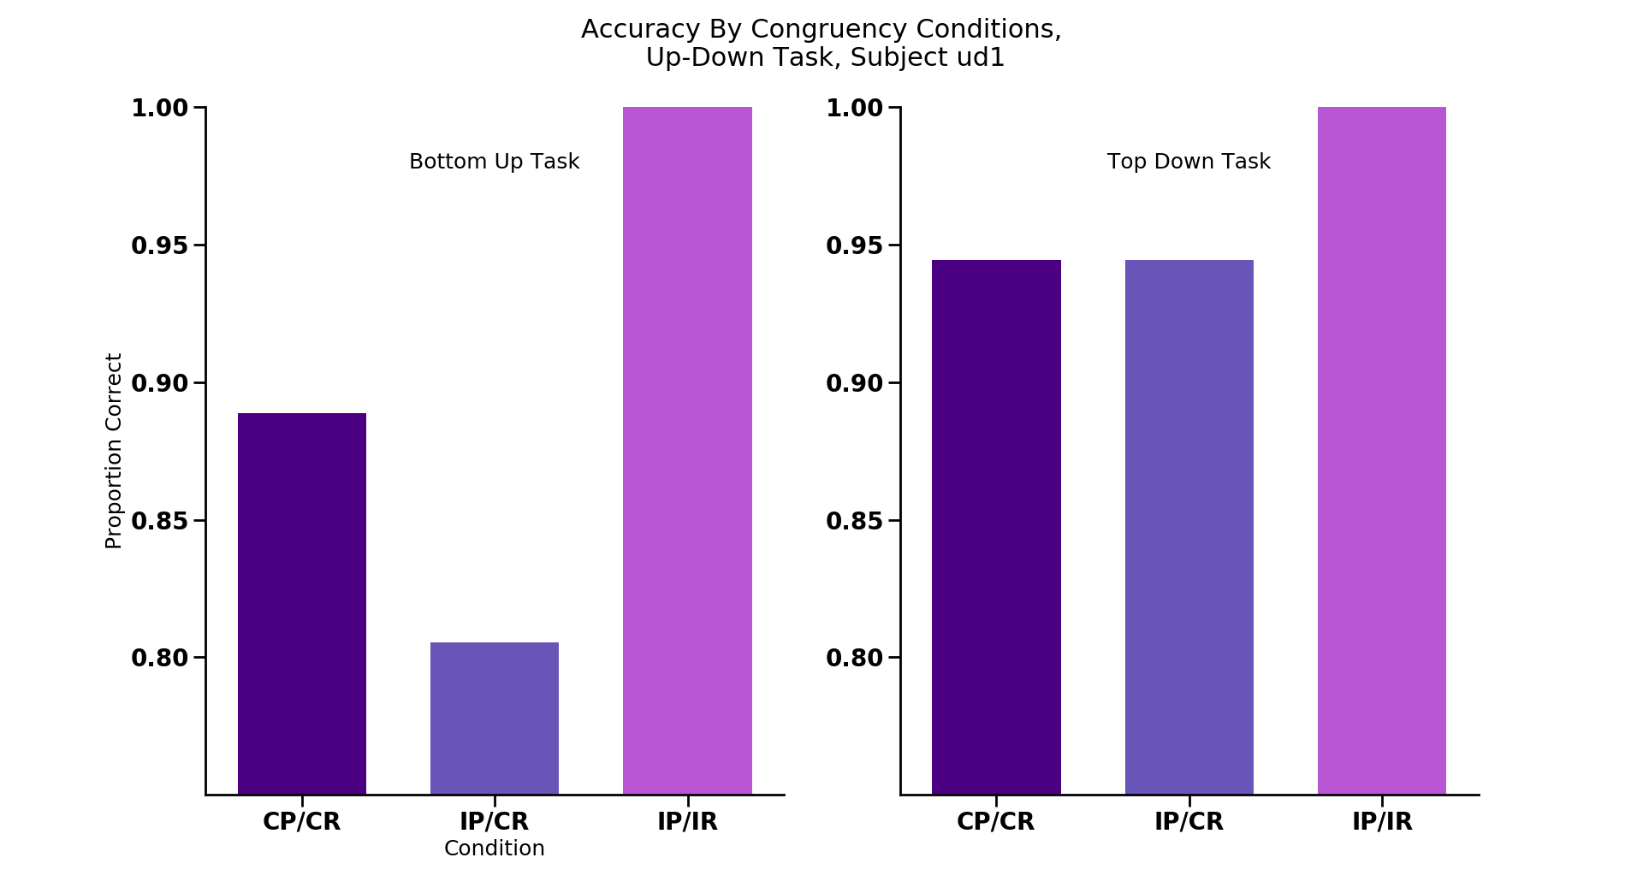
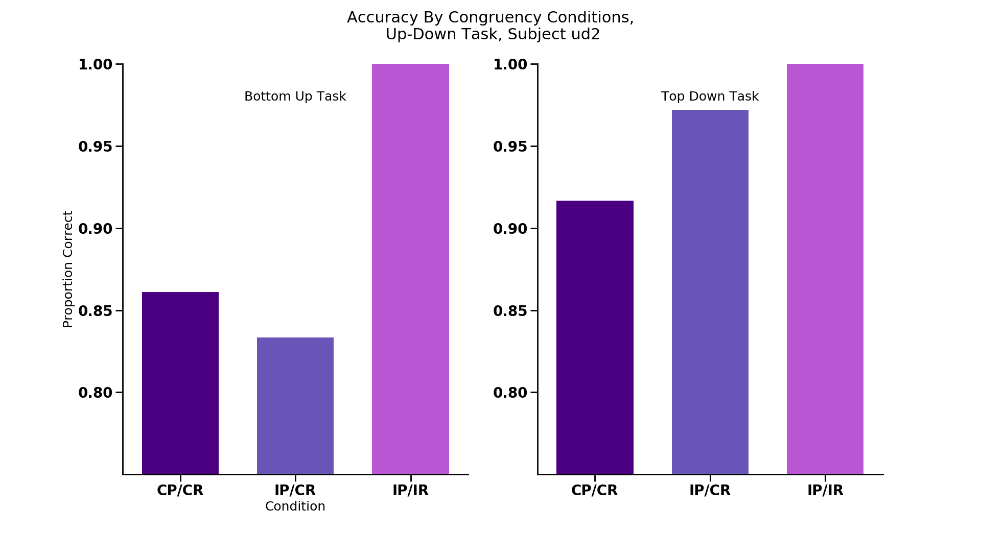
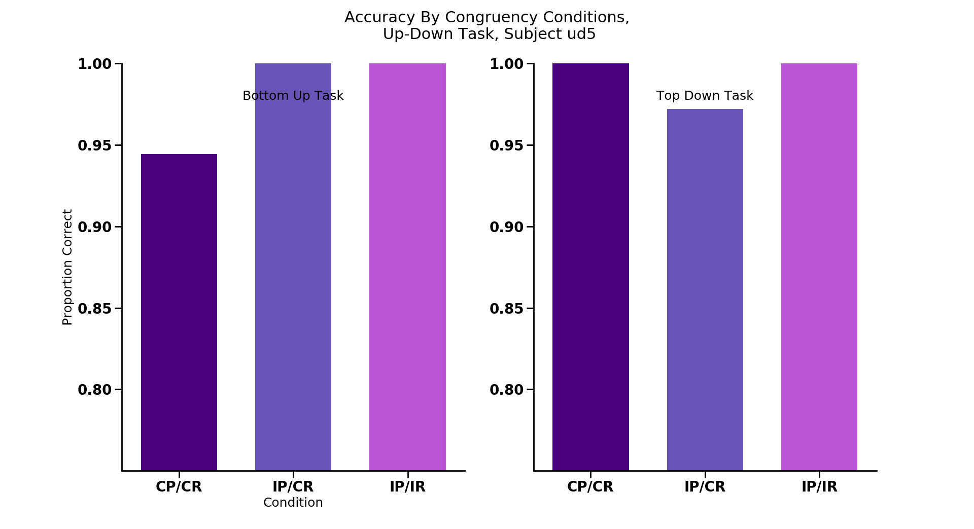
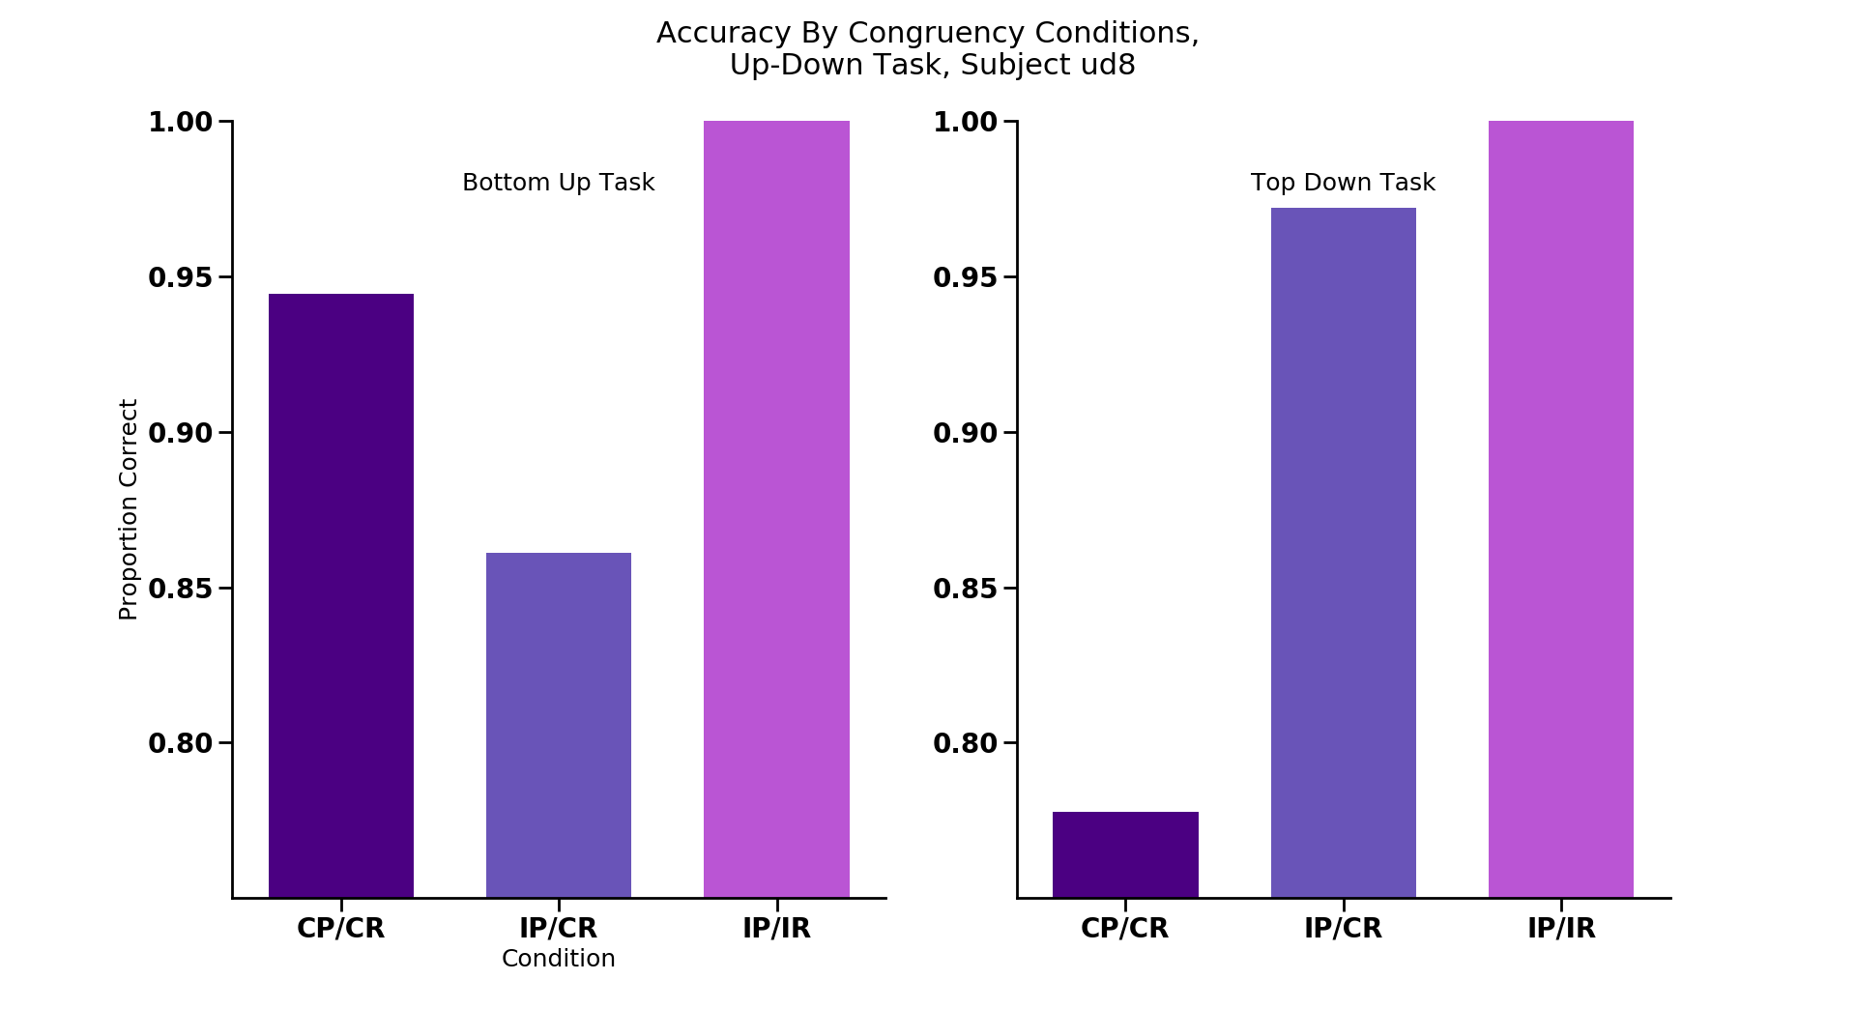
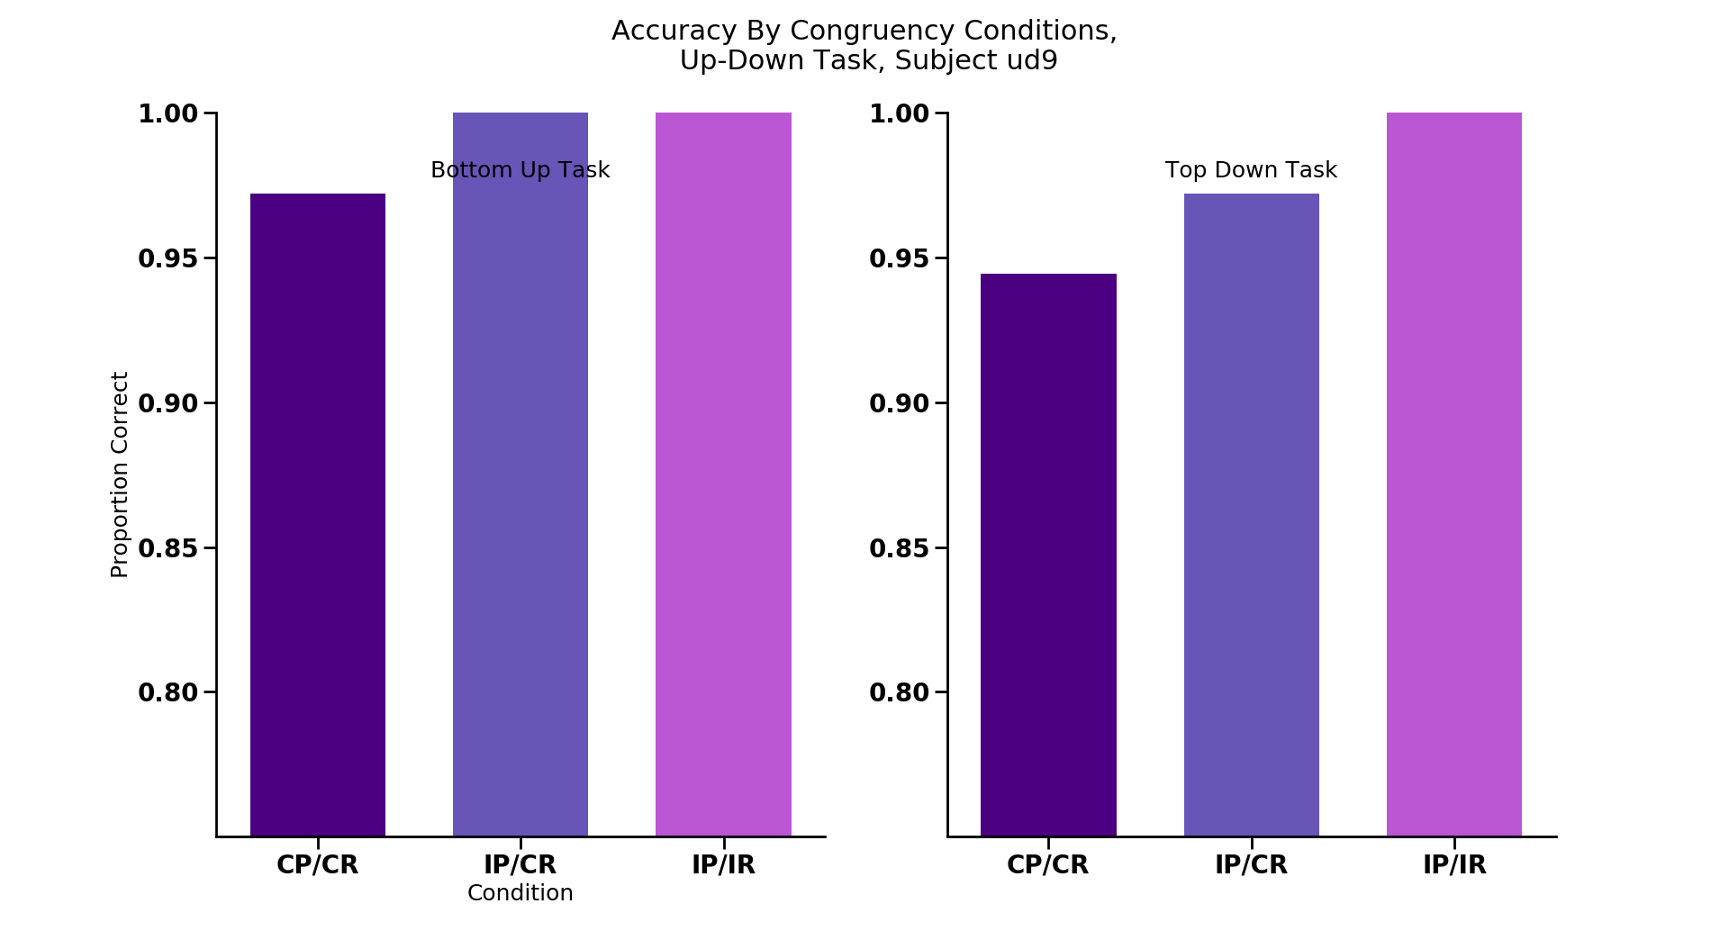
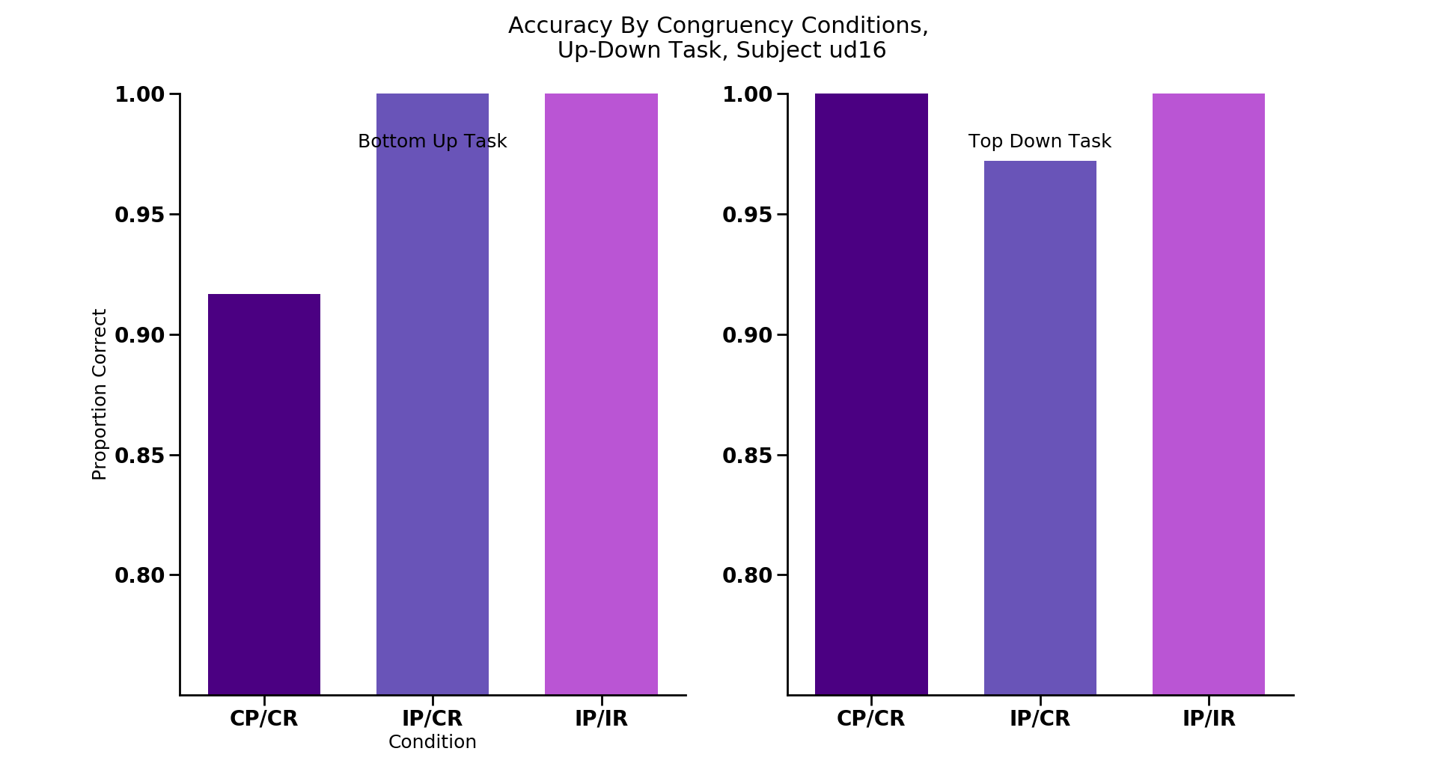
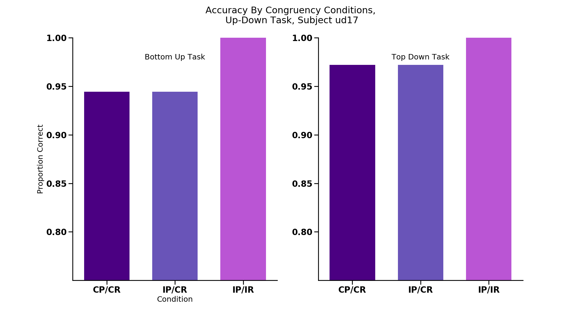
*
*
*
*
CC
IC
II
CC
IC
II
CC
IC
II
CC
IC
II
CC
IC
II
CC
IC
II
CC
IC
II
CC
IC
II
*
CC
IC
II
CC
IC
II
CC
IC
II
CC
IC
II
CC
IC
II
CC
IC
II
Notes:
NON-REPLICATING SUBJECTS: each congruency condition ACCURACY

Slide 26
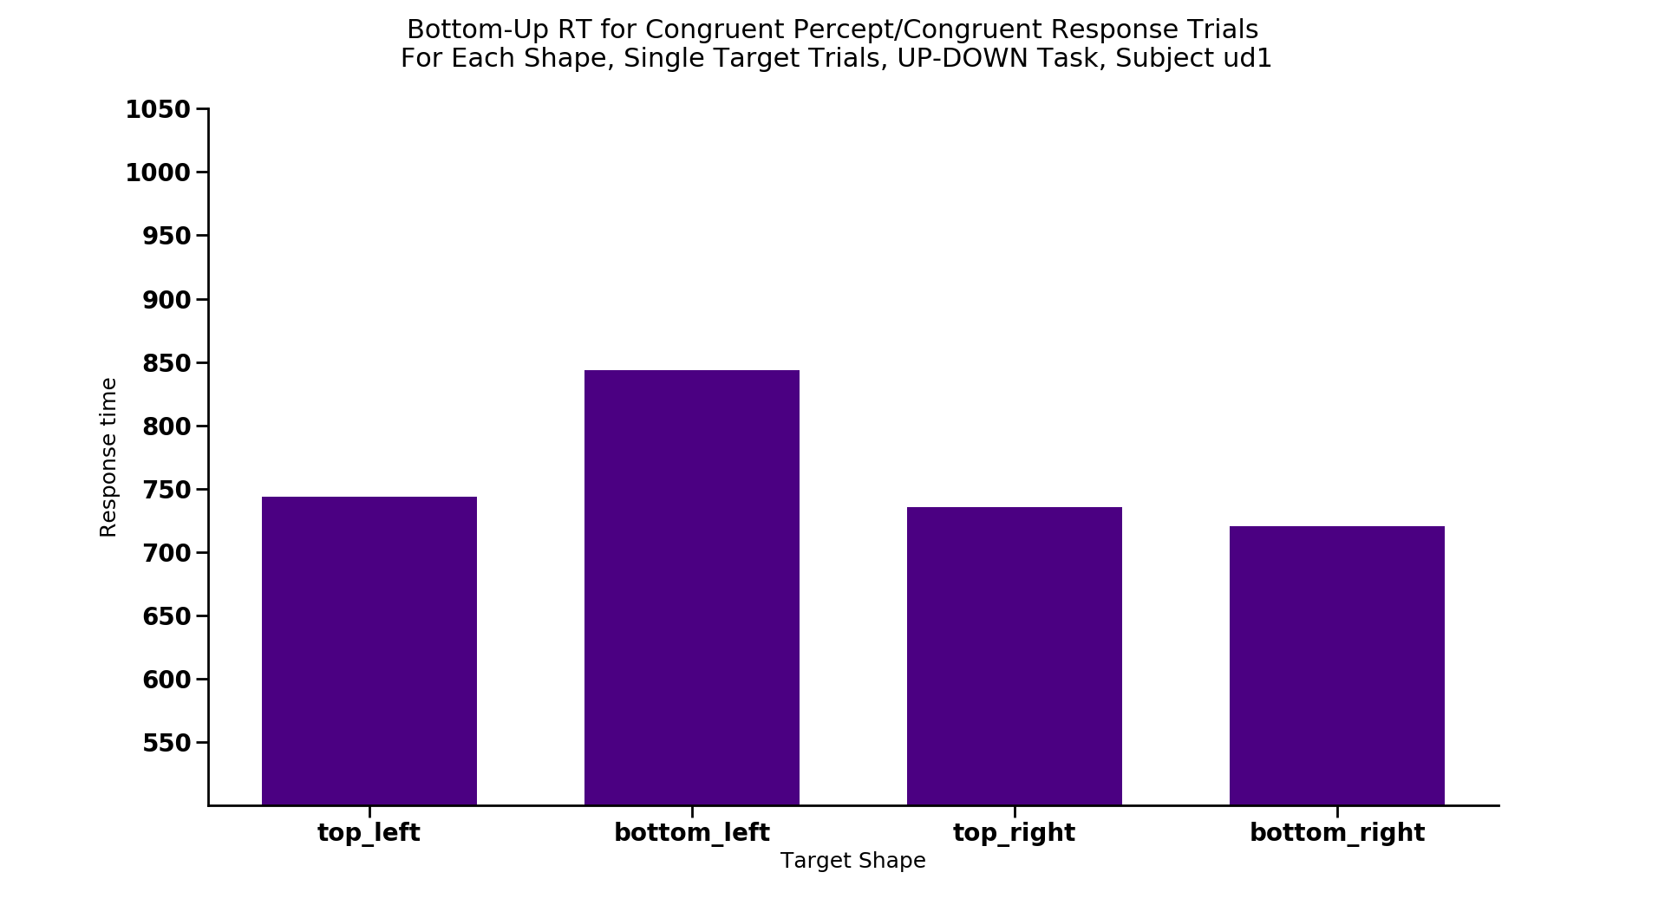
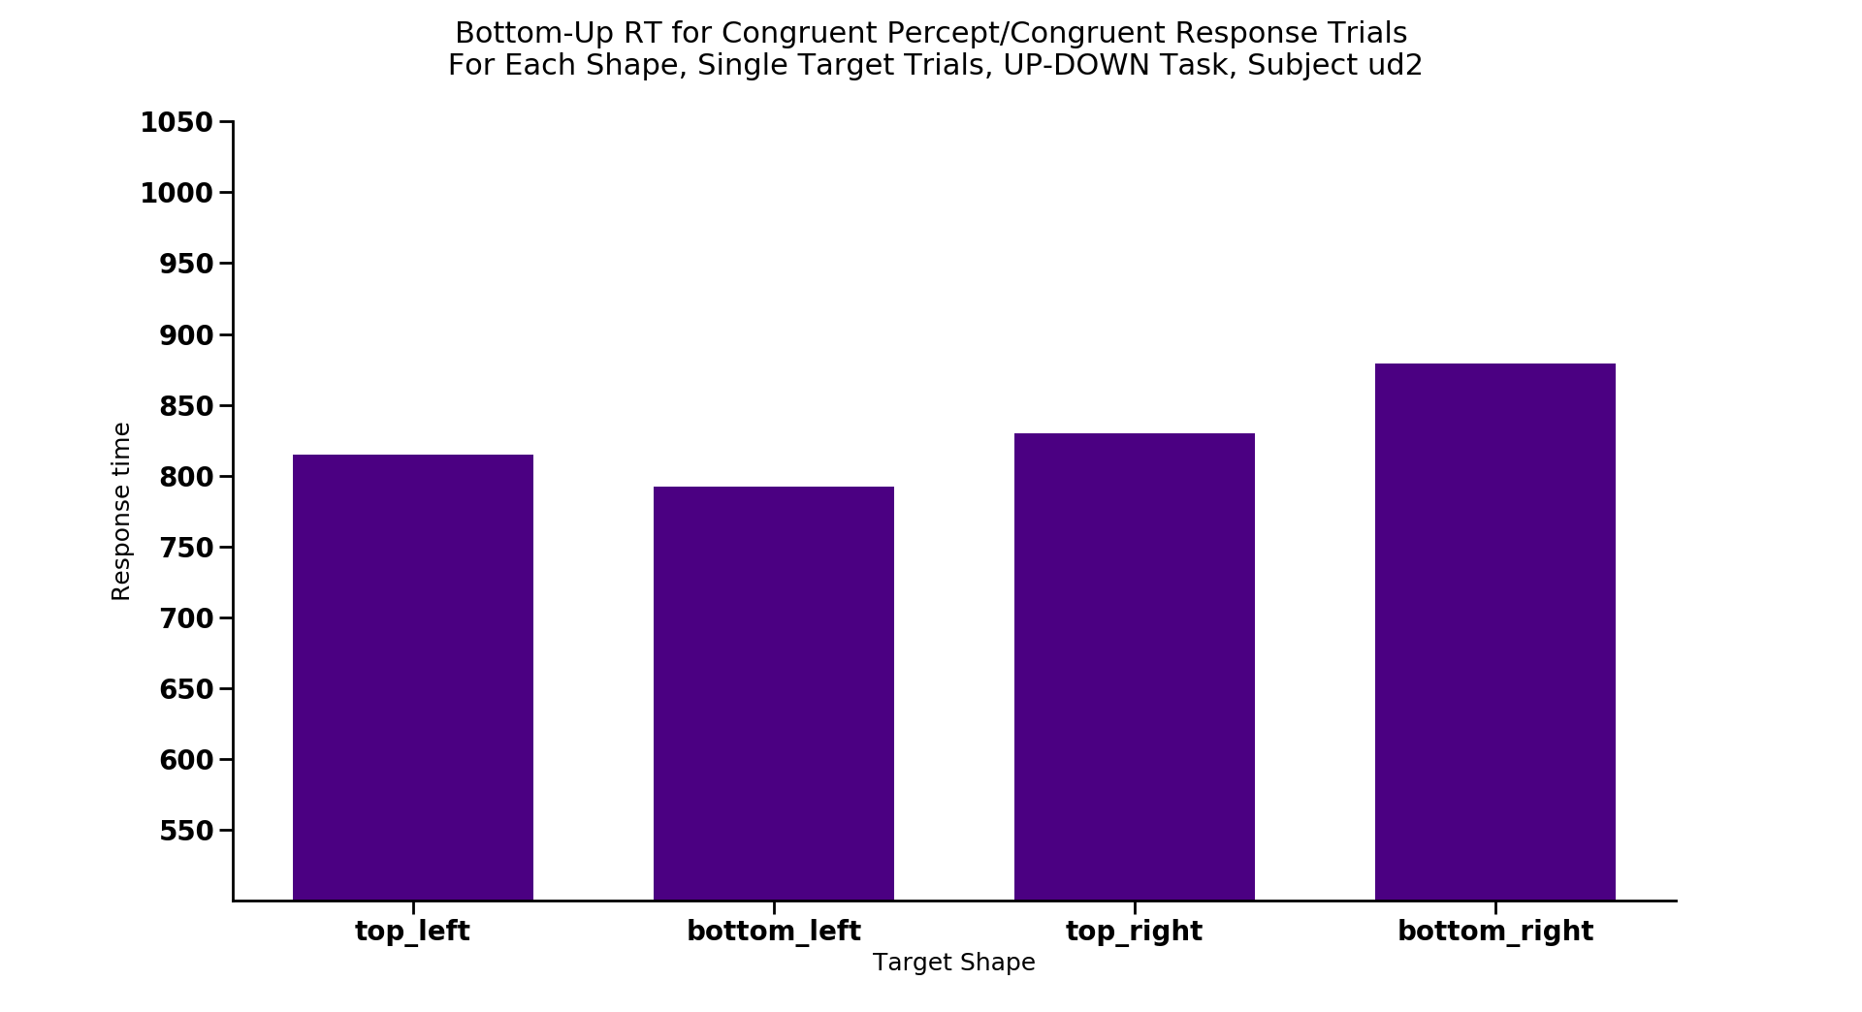
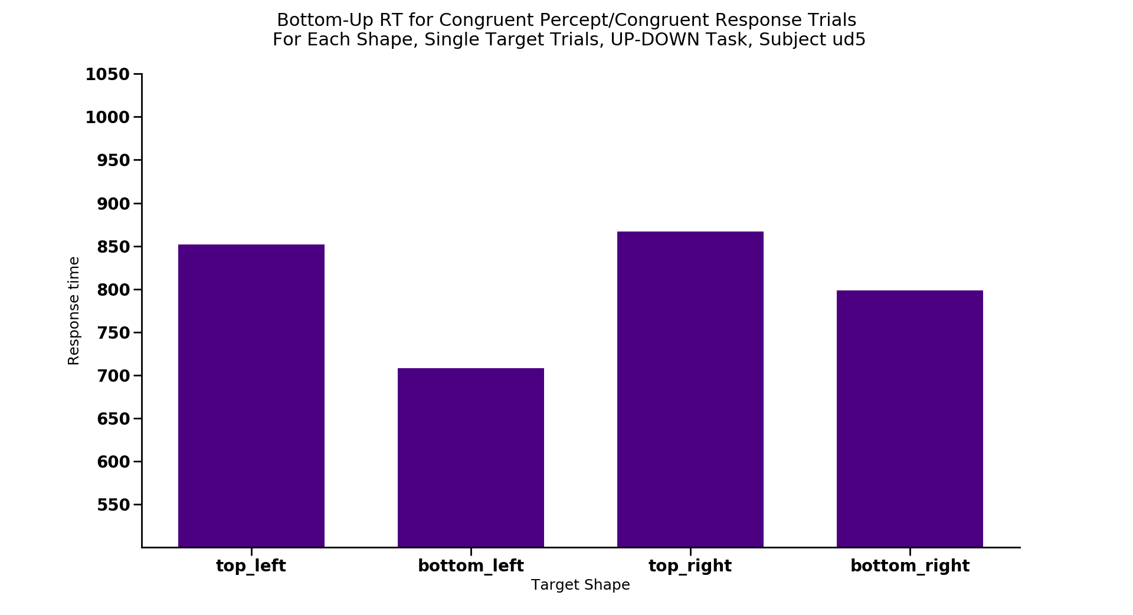
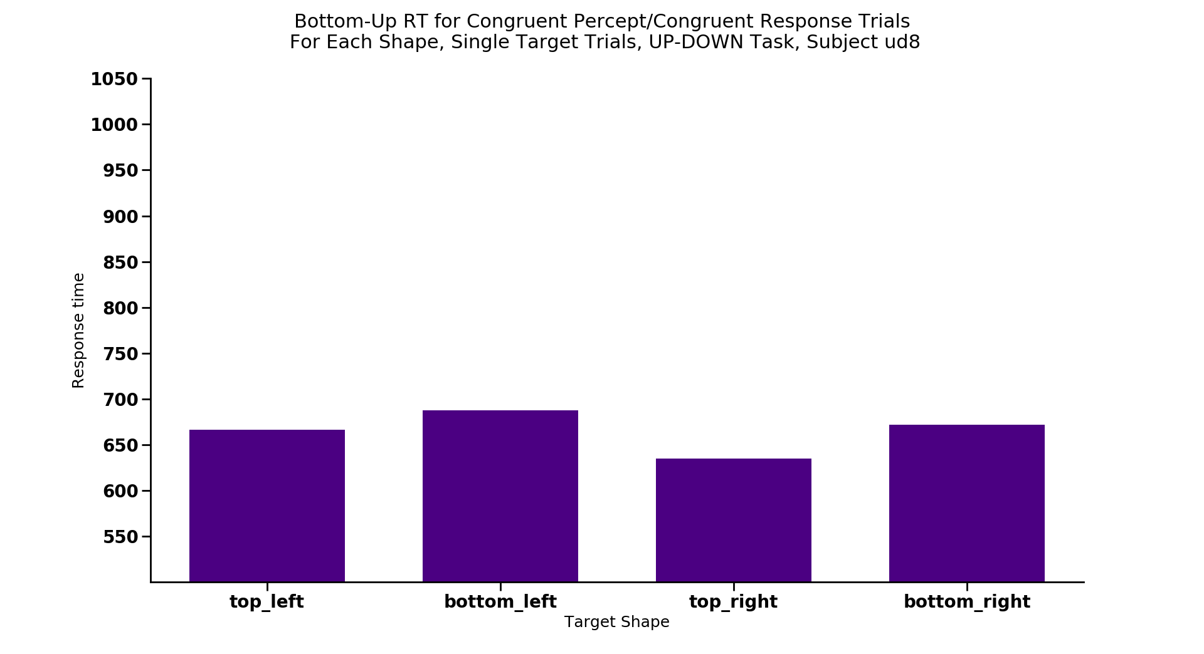
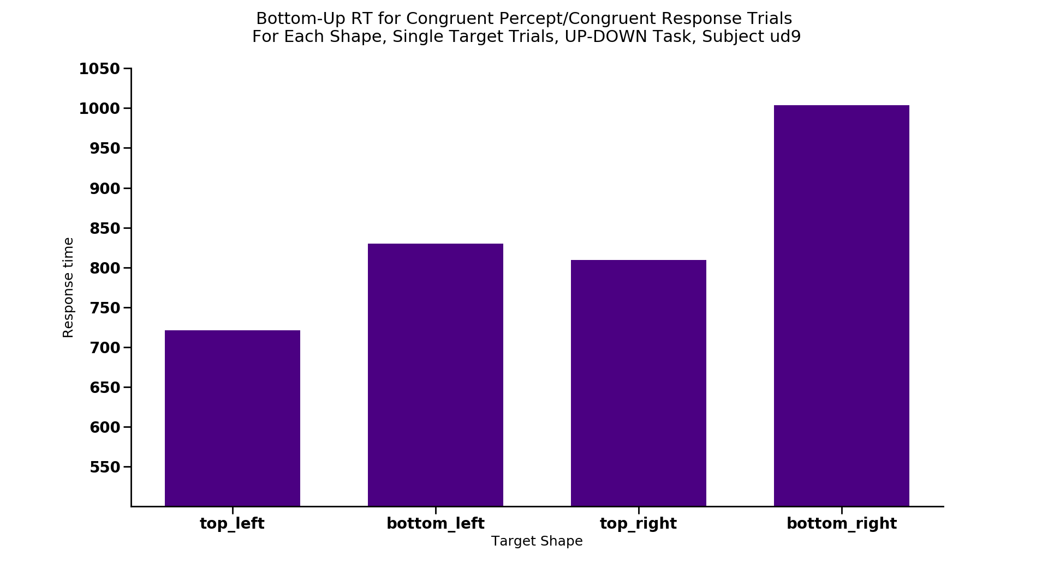
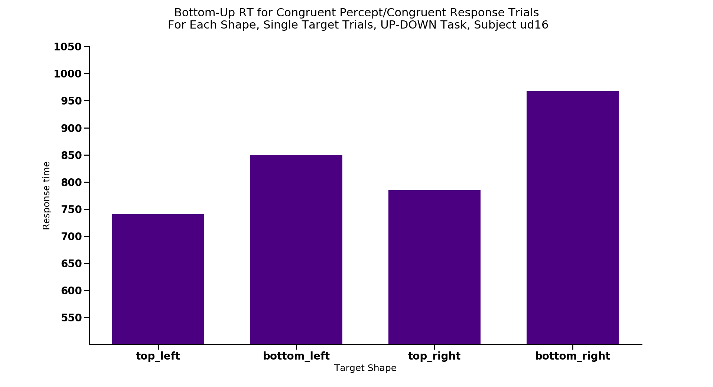
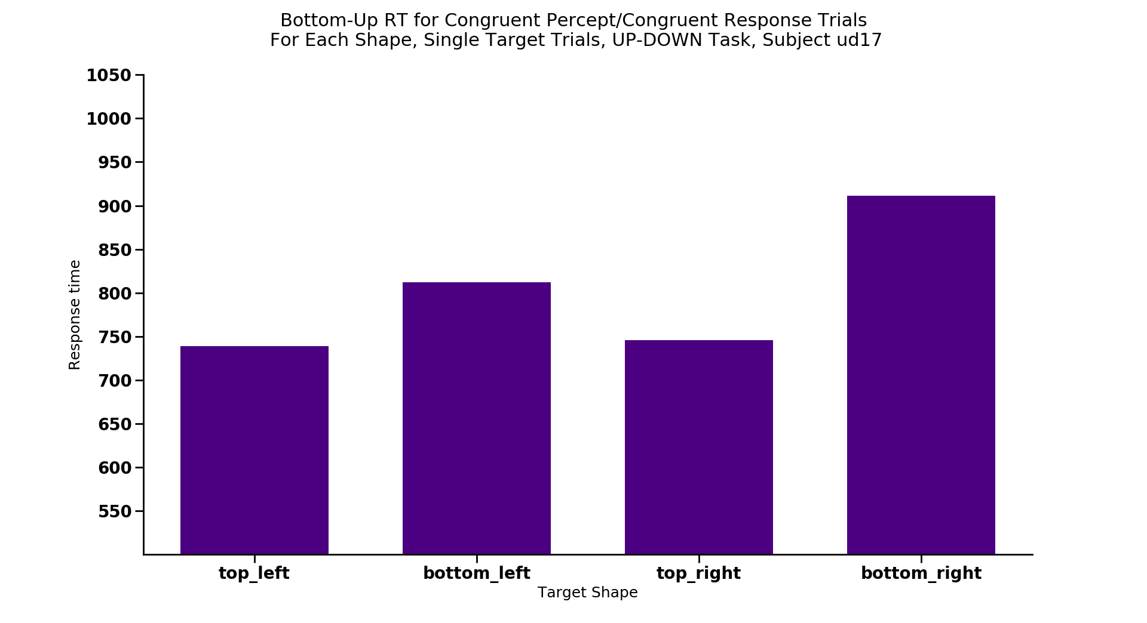
*
*
*
*
*
Notes:
Max 12 trials each

Slide 27
Congruent/Congruent = FASTEST condition

Slide 28
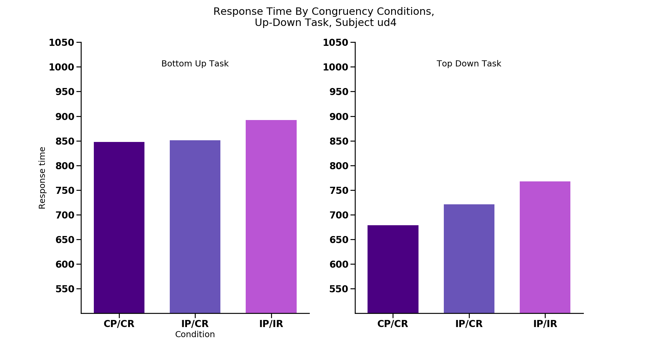
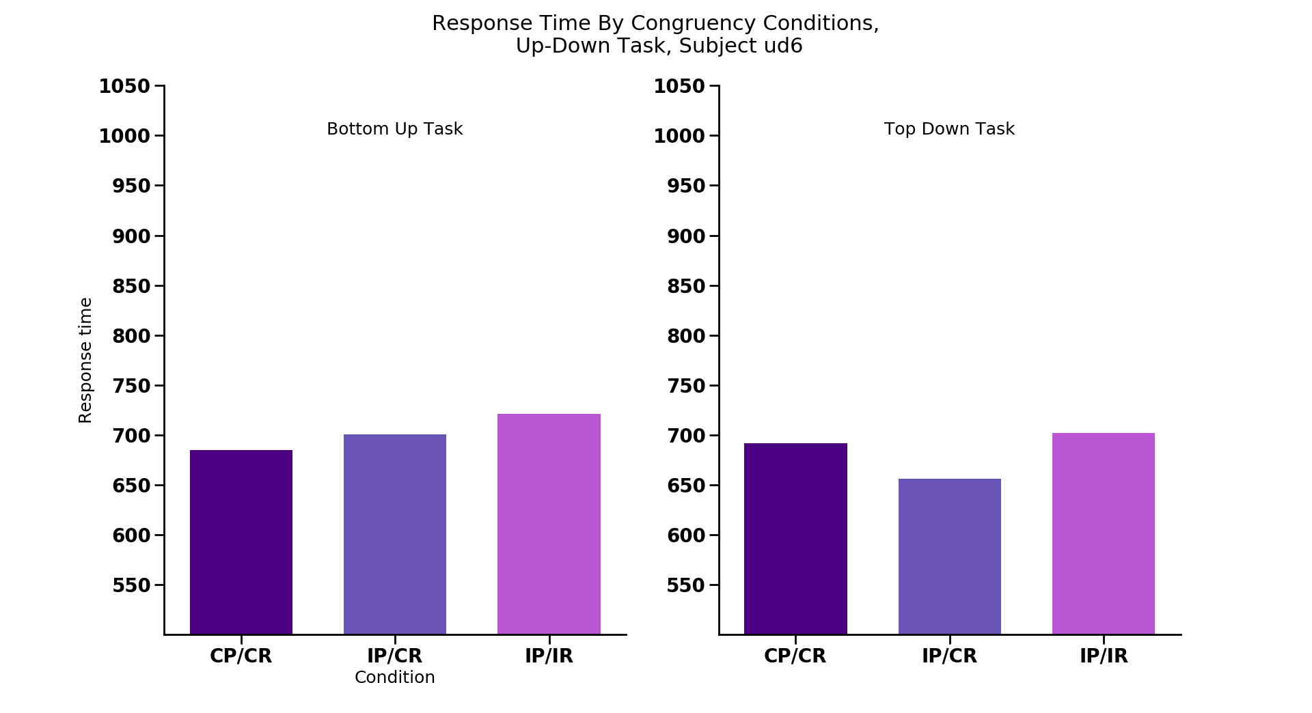
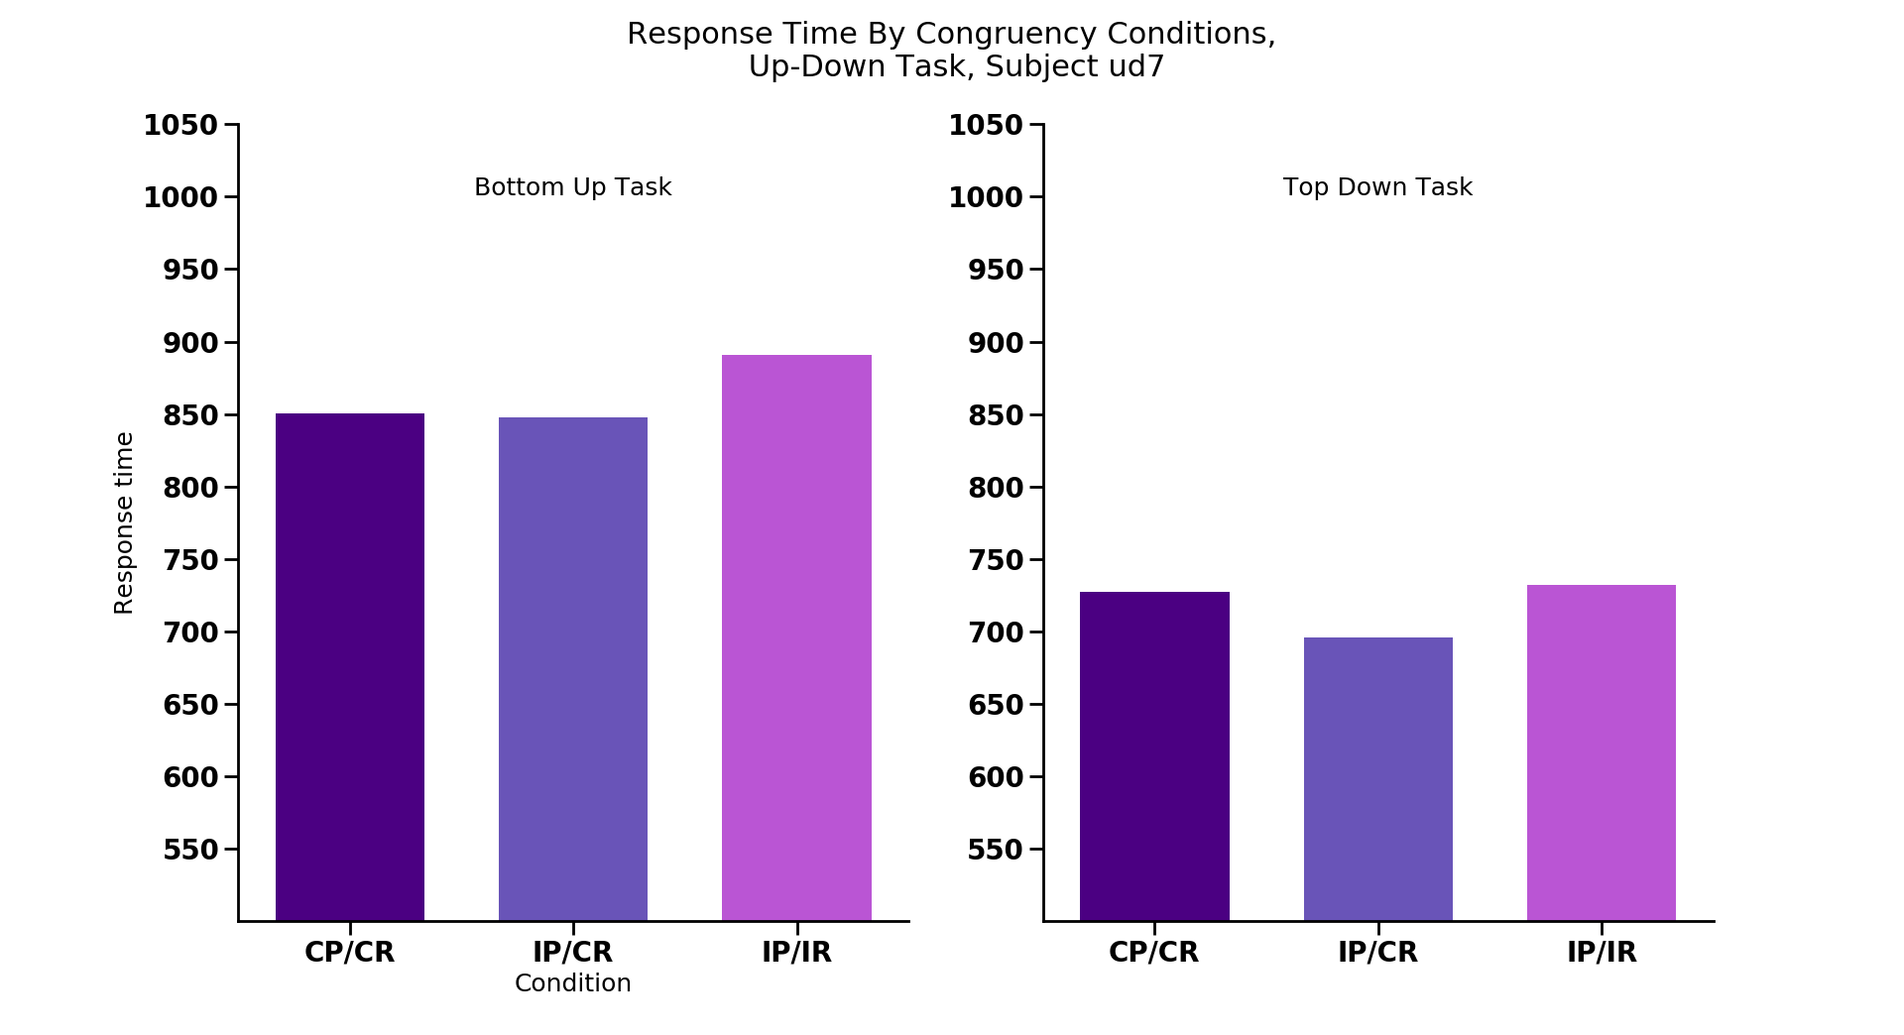
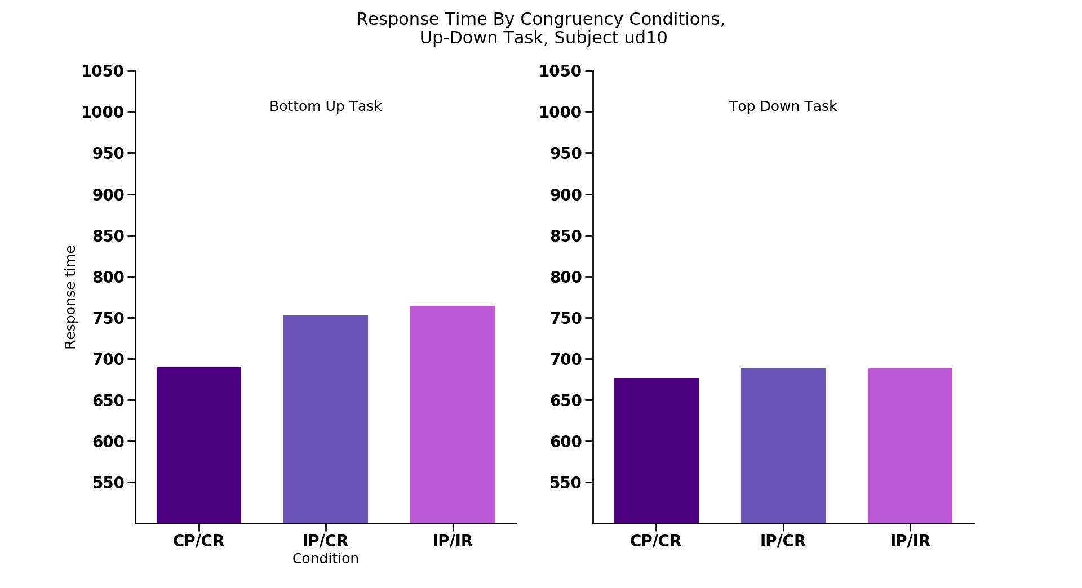
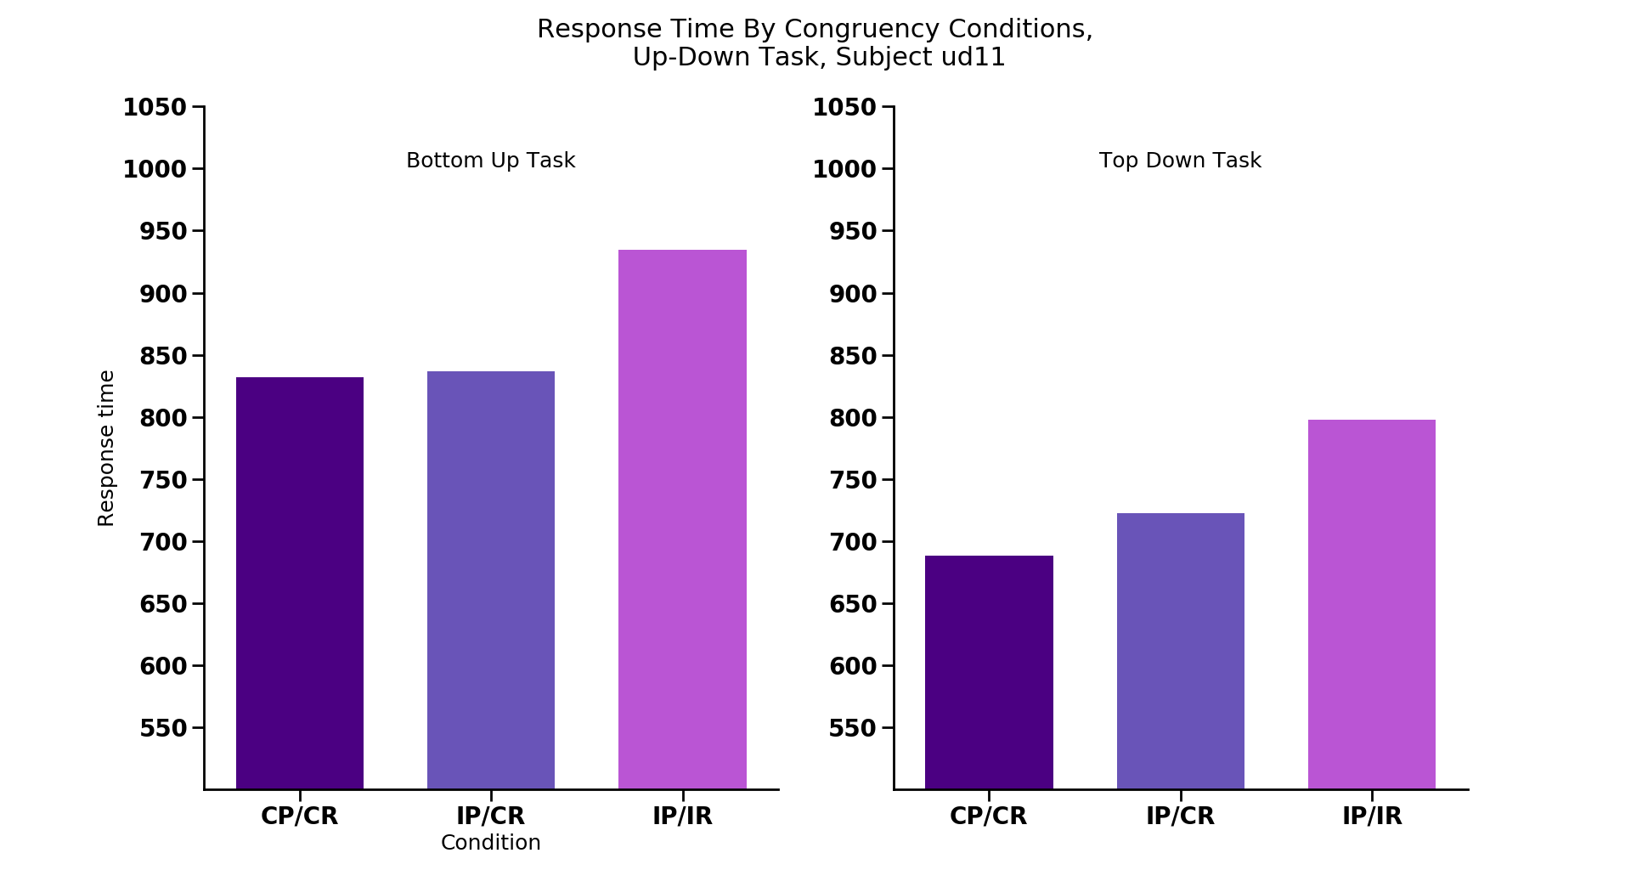
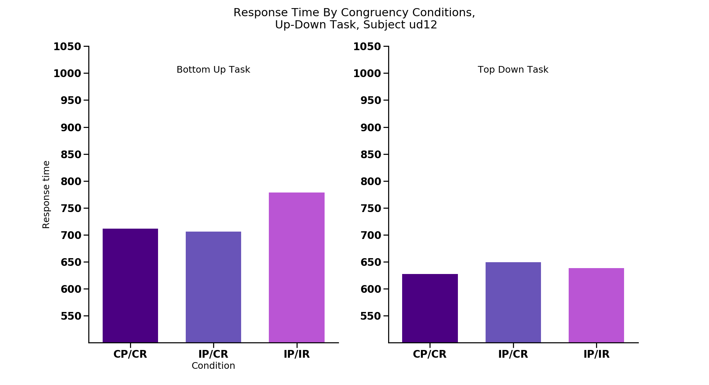
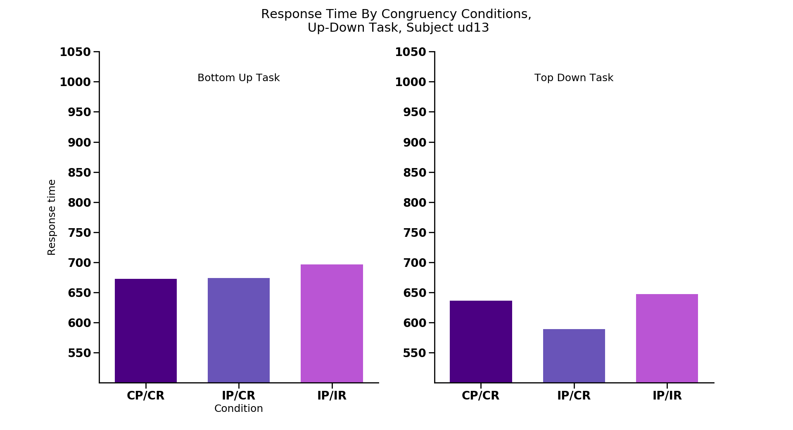
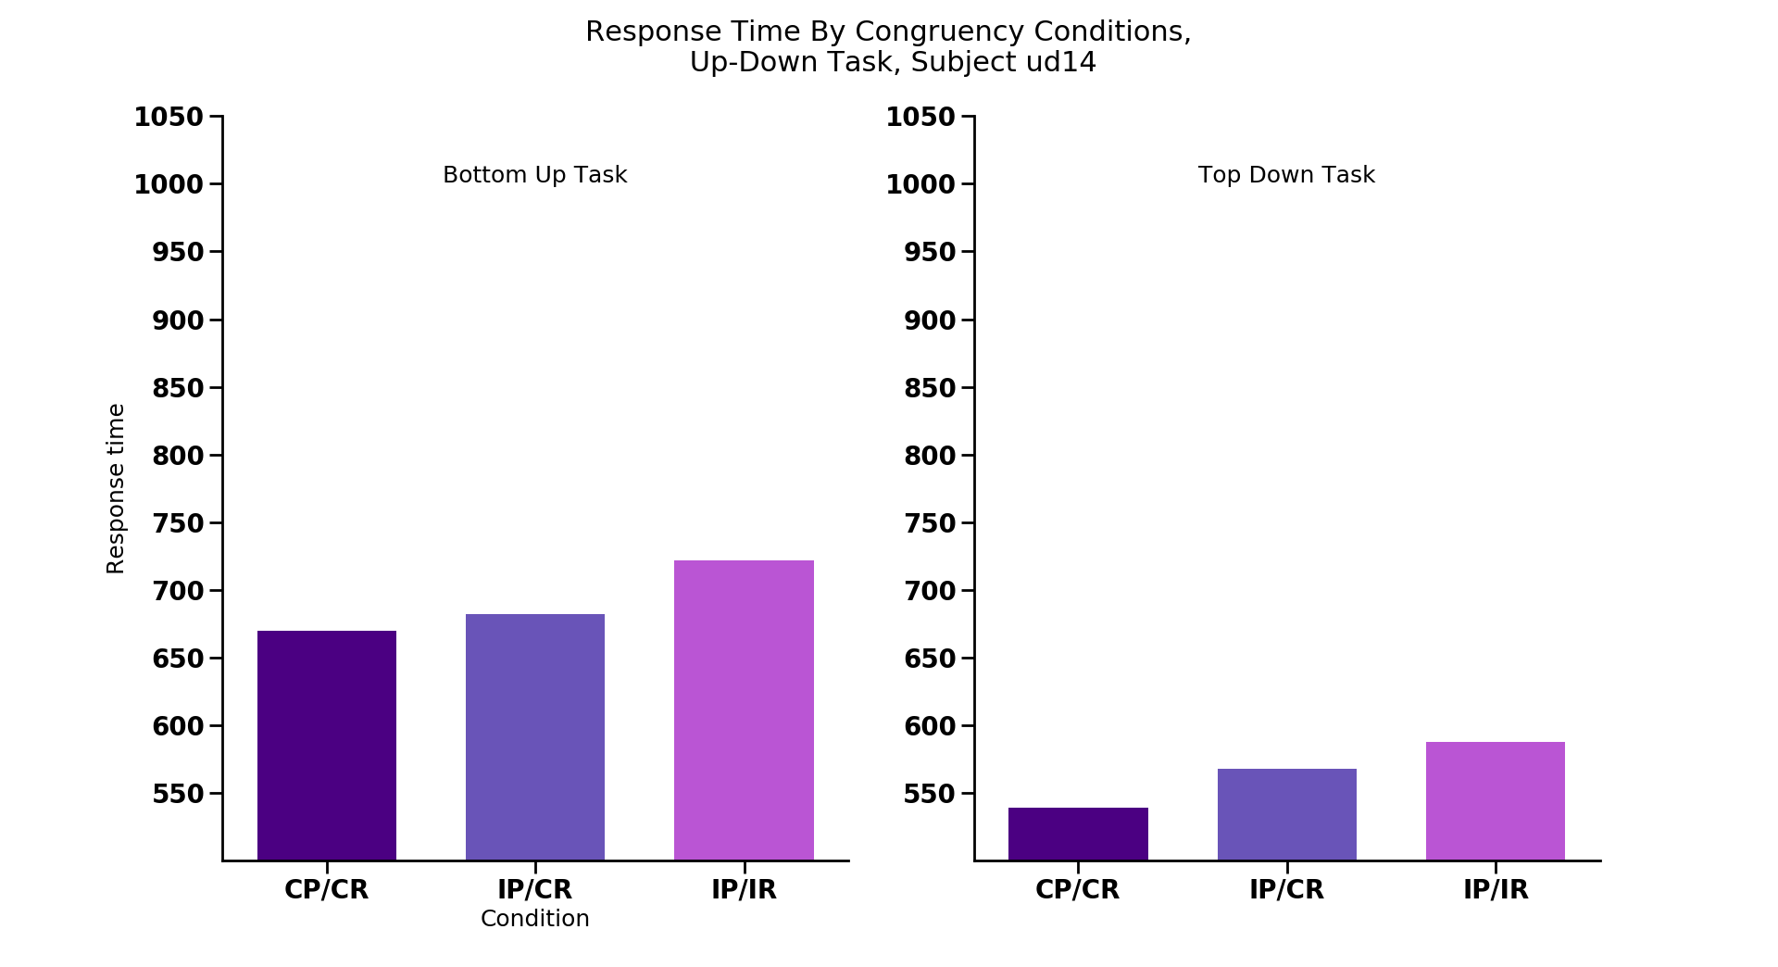

CC
IC
II
CC
IC
II
CC
IC
II
CC
IC
II
CC
IC
II
CC
IC
II
CC
IC
II
CC
IC
II
CC
IC
II
CC
IC
II
CC
IC
II
CC
IC
II
CC
IC
II
CC
IC
II
CC
IC
II
CC
IC
II
CC
IC
II
CC
IC
II
Notes:
Replications congruency stuff
Ud4, ud6, ud7, ud10, ud11, ud12, ud13, ud14, ud15

Slide 29









CC
IC
II
CC
IC
II
CC
IC
II
CC
IC
II
CC
IC
II
CC
IC
II
CC
IC
II
CC
IC
II
CC
IC
II
CC
IC
II
CC
IC
II
CC
IC
II
CC
IC
II
CC
IC
II
CC
IC
II
CC
IC
II
CC
IC
II
CC
IC
II
Notes:
Replications congruency accuracy

Slide 30









Notes:
ST BIAS

Slide 31

One target
Cong/Cong
UP
UP
Incong/Cong
Incong/Incong
UP
UP
UP
DOWN
Notes:
TRIAL TYPE PREVIOUS SET UP BY WHICH TRIAL TYPE IT WAS

Slide 32
Statistics
Bottom up congruency ANOVA:
Main effect of congruency: F_{2,15} = 10.8, p < 0.001
Follow-up t-tests (corrected p value = 0.0167):
Congruent/congruent vs. incongruent/incongruent:
T₁₅ = 2.40, p = 0.029
Congruent/congruent vs. incongruent/congruent:
T₁₅ = 1.78, p = 0.09
Incongruent/congruent vs. incongruent/incongruent:
T₁₅ = 6.03, p < 0.001*

Slide 33
Statistics
Top down congruency ANOVA:
Main effect of congruency: F_{2,15} = 10.36, p < 0.001
Follow-up t-tests (corrected p value = 0.0167):
Congruent/congruent vs. incongruent/incongruent:
T₁₅ = 3.46, p < 0.005 *
Congruent/congruent vs. incongruent/congruent:
T₁₅ = 0.08, p = 0.94
Incongruent/congruent vs. incongruent/incongruent:
T₁₅ = 4.86, p < 0.001*

Slide 34

Source of conflict during search with redundant targets: data update
James Wilmott
April 24, 2018
‘Up’
‘Down’
Notes:
Scitoons:
different levels of attention (feature vs spatial vs object attention)
blindsight

Slide 35
Dissociating perceptual and response congruence effects
Task: Report whether the cut off side is on the top or bottom of one odd-colored target
Press ‘up’
Press ‘down’
Notes:
Always one of each type of shape as a distractor (6 stimuli overall)
Color known beforehand, searching for the odd colored target - ‘Bottom up’
Color known – ‘Top down’

Slide 36
Dissociating perceptual and response congruence effects
Perceptual Congruent,
Response Congruent
Perceptual Incongruent,
Response Congruent
Perceptual Incongruent,
Response Incongruent
Shapes same
Shapes different
Shapes different
Responses same
Responses same
Responses different
‘Up’
‘Up’
‘Up’
‘Up’
‘Up’
‘Down’
Notes:
Predictions next

Slide 37
Hypothesis 1- Perceptual incongruence of targets leads to worse performance
RT
Shapes same
Shapes different
Shapes different
Responses same
Responses same
Responses different
‘Up’
‘Up’
‘Up’
‘Up’
‘Up’
‘Down’
Notes:
Predictions
Cong/cong < incong/cong = incong/incong

Slide 38
Hypothesis 2- Response incongruence leads to worse performance
RT
Shapes same
Shapes different
Shapes different
Responses same
Responses same
Responses different
‘Up’
‘Up’
‘Up’
‘Up’
‘Up’
‘Down’
Notes:
Cong/cong = incong/cong < incong/incong

Slide 39
Hypothesis 3- Combination of perceptual and response incongruence
RT
Shapes same
Shapes different
Shapes different
Responses same
Responses same
Responses different
‘Up’
‘Up’
‘Up’
‘Up’
‘Up’
‘Down’
Notes:
Cong/cong < incong/cong < incong/incong
Hammer home that we predict the shape same/response same trials to be fastest under all of our hypotheses

Slide 40

Percept
Response
UP
UP
UP
UP
UP
DOWN
N = 16
Notes:
BU Slower RTs for the all congruent condition: (7/16)
Ud1 (also TD), ud2 (also for TD, small), ud5 (large), ud8, ud9 (large), ud16, ud17
Speed accuracy tradeoff? Ud1, ud2, ud5, ud8
Not showing slower RTs for congruent condition: (9/16)
Ud4, ud6, ud7, ud10, ud11, ud12, ud13, ud14, ud15
Bottom up: significant ANOVA. Left and center not diff (p = 0.09), both different from right
Top down: significant ANOVA. Left and center not diff, both diff from right
N-1 , prior trial comparisons
Single target response stuff
Make sure redundnacy for comparisons against same response condition stuff

Slide 41

Percept
Response
UP
UP
UP
UP
UP
DOWN
UP
UP
UP
UP
UP
DOWN
N = 16
Notes:
Lower accuracy for middle congruency (BU): (8/16)
Ud1, ud2 (small), ud4 (also for TD), ud6, ud7 (also for TD), ud8, ud11, ud12
Not lower accuracy for middle congruence: (8/16)
Ud5 (shows much longer Rts for the congruent/congruent trials), ud9, ud10 (80% across the board), ud13 (85% across the board), ud14, ud15, ud16, ud17

Slide 42

N = 16
Notes:
Slower RTs for 2 targets:
Ud2, ud4, ud5, ud6, ud8, ud9, ud11, ud12, ud13, ud14, ud16, ud17
Not so:
Ud1, ud7, ud10, ud15
Significant difference on left, not on right
ANOVA with the individual two target cases

Slide 43

N = 16

Slide 44
10 participants

Slide 45

Percept
Response
UP
UP
UP
UP
UP
DOWN
UP
UP
UP
UP
UP
DOWN
Notes:
BU Slower RTs for the all congruent condition:
Ud1 (also TD), ud2 (also for TD, small), ud5 (large), ud8, ud9 (large), ud16, ud17
Speed accuracy tradeoff? Ud1, ud2, ud5, ud8
Not showing slower RTs for congruent condition:
Ud4, ud6, ud7, ud10, ud11, ud12, ud13, ud14, ud15
Variability across different subsets of each condition (BU and TD):
Ud1, ud2, ud4, ud5, ud6, ud7, ud8, ud9, ud10, ud11

Slide 46

Percept
Response
UP
UP
UP
UP
UP
DOWN
UP
UP
UP
UP
UP
DOWN
Notes:
Lower accuracy for middle congruency (BU):
Ud1, ud2 (small), ud4 (also for TD), ud6, ud7 (also for TD), ud8, ud11, ud12
Not lower accuracy for middle congruence:
Ud5 (shows much longer Rts for the congruent/congruent trials), ud9, ud10 (80% across the board), ud13 (85% across the board), ud14, ud15, ud16, ud17

Slide 47

Notes:
Slower RTs for 2 targets:
Ud2, ud4, ud5, ud6, ud8, ud9, ud11, ud12, ud13, ud14, ud16, ud17
Not so:
Ud1, ud7, ud10, ud15

Slide 48


Slide 49
Source of conflict during search with redundant targets: data update
James Wilmott
March 12, 2018
‘Up’
‘Down’
Notes:
Scitoons:
different levels of attention (feature vs spatial vs object attention)
blindsight

Slide 50

Notes:
- Main goal was to contrast search performance when there was one vs. two targets
Subjects instructed to fixate a center cross (no eye movements)
Target(s) were defined as odd-colored item
Manipulated number of target items in display

Slide 51

Reaction time slower when target shapes were different than when the same
Experiment 1B; N = 15
Notes:
Same trials = same shape, same potential response
Different trials = different shape, different response

Slide 52
Why do different target shapes lead to worse performance?

Slide 53
Why do different target shapes lead to worse performance?
Hypothesis 1: Perceptual incongruence of targets
Weaker perceptual grouping for different trials
Conflict between perceptual representations

Slide 54
Why do different target shapes lead to worse performance?
Hypothesis 1: Perceptual incongruence of targets
Weaker perceptual grouping for different trials
Conflict between perceptual representations during encoding
Hypothesis 2: Response incongruence of targets
Conflict between potential responses

Slide 55
Why do different target shapes lead to worse performance?
Hypothesis 1: Perceptual incongruence of targets
Weaker perceptual grouping for different trials
Conflict between perceptual representations
Hypothesis 2: Response incongruence of targets
Conflict between potential responses
Hypothesis 3: Combination of H1 and H2

Slide 56
Does top-down knowledge modulate incongruence effect?
Notes:
The tasks up to now have required subjects to rely on bottom-up perceptual processes to identify and locate the target item.
Does having knowledge about the identity of target-defining feature modulate the incongruence effect?
e.g., if the subject knows what color to look for before the search array is displayed

Slide 57
Dissociating perceptual and response congruence effects
Task: Report whether the cut off side is on the top or bottom of one odd-colored target
Press ‘up’
Press ‘down’
Notes:
Always one of each type of shape as a distractor (6 stimuli overall)
Color known beforehand, searching for the odd colored target - ‘Bottom up’
Color known – ‘Top down’

Slide 58
Dissociating perceptual and response congruence effects
Perceptual Congruent,
Response Congruent
Perceptual Incongruent,
Response Congruent
Perceptual Incongruent,
Response Incongruent
Shapes same
Shapes different
Shapes different
Responses same
Responses same
Responses different
‘Up’
‘Up’
‘Up’
‘Up’
‘Up’
‘Down’
Notes:
Predictions next

Slide 59
Hypothesis 1- Perceptual incongruence of targets leads to worse performance
RT
Shapes same
Shapes different
Shapes different
Responses same
Responses same
Responses different
‘Up’
‘Up’
‘Up’
‘Up’
‘Up’
‘Down’
Notes:
Predictions
Cong/cong < incong/cong = incong/incong

Slide 60
Hypothesis 2- Response incongruence leads to worse performance
RT
Shapes same
Shapes different
Shapes different
Responses same
Responses same
Responses different
‘Up’
‘Up’
‘Up’
‘Up’
‘Up’
‘Down’
Notes:
Cong/cong = incong/cong < incong/incong

Slide 61
Hypothesis 3- Combination of perceptual and response incongruence
RT
Shapes same
Shapes different
Shapes different
Responses same
Responses same
Responses different
‘Up’
‘Up’
‘Up’
‘Up’
‘Up’
‘Down’
Notes:
Cong/cong < incong/cong < incong/incong
Hammer home that we predict the shape same/response same trials to be fastest under all of our hypotheses

Slide 62
Data
5 subjects
Notes:
Ran 6, excluded 1 for poor performance

Slide 63

Bottom up task: slower RTs for two target displays
Notes:
Bottom-up results mirror what our previous tasks

Slide 64
Top down task: no difference

Slide 65

Accuracy exhibits similar pattern to RT
Notes:
Bottom up: Replicates previous paradigms

Slide 66

Two target trials: congruency effect is noisy
Percept
Response
UP
UP
UP
UP
UP
DOWN
UP
UP
UP
UP
UP
DOWN
Notes:
Max 48 trials each, then subtract incorrect trials

Slide 67
Top-down task: looks reasonable
Percept
Response
UP
UP
UP
UP
UP
DOWN
UP
UP
UP
UP
UP
DOWN
Notes:
Top down looks like what we’d expect from Hypothesis 2 (response incongruence is the cause of congruence effects)
Cong/cong: if surprise, might take more control (cavanagh and frank theta as cc mechanism paper)
Surprise for both outer ones (don’t overlap with each other at all)
Left one is surprising due to perceptual similairty, right with response similarity
If setting point for congitive control due to a combo of those, the middle condition would be the set point and need to adjust from that hence longer RT
How do speed accuracy tradeoff plays a role in this ?

Slide 68

Two target trials: congruency effect is noisy
Percept
Response
UP
UP
UP
UP
UP
DOWN
UP
UP
UP
UP
UP
DOWN
Notes:
Incong per/ cong per accuracy: [0.8 – 1.0]

Slide 69

Intra-subject variability in same shape/same response trials
Subject 1
Notes:
Clear variability
Max 12 trials each

Slide 70

Intra-subject variability in same shape/same response trials
Subject 2
Notes:
No systematic trends across subject…
Max 12 trials each

Slide 71
If congruency effect is real: unlikely it has to do with grouping due to distractor shape
Shape same/response same displays always had three items with the same shape

Slide 72
If congruency effect is real: unlikely it has to do with grouping due to distractor shape
Shape same/response same displays always had three items with the same shape
Shape different trials never did

Slide 73
If congruency effect is real: unlikely it has to do with grouping due to distractor shape
Shape same/response same displays always had three items with the same shape
Shape different trials never did
Everything else held equal, we’d expect RT to decrease with more same-shaped items
RT
Notes:
Point?

Slide 74
One target trials: two and three items with the same shape don’t differ
Notes:
Point- we can look at single target trials to see what the effect of nr of matching shapes has on target discrimination

Slide 75

One target trials: two and three items with the same shape don’t differ
Notes:
Large variance: some subjects do show longer Rts for the 3 conditions

Slide 76
Takeaway: noisy data, need more subjects

Slide 77
Thanks!

Slide 78
Previous trial
Repeated resp.
Switched resp.
One target
Same/Same
Different/Same
Different/Different
Current trial
Notes:
This is the same from slide 2, just isolated bottom-up
Analysis:
1. check accoridng to whetehr response itself was repeated ornot repeated for each type of two target trial (collapsing across all 2 target trial types, and with the 1 target trial type )
2. Gratton (Grafton?) effect analysis (switching between congruent previous vs. incongruent previous trial) sequence effects
3. Separate out the response trials wrt to whether the same response or diff response (e.g., cong/cong trials, whether same response as this trial or different response)

Slide 79
Previous trial
Repeated resp.
Switched resp.
One target
Same/Same
Different/Same
Different/Different
Current trial
Notes:
This is the same from slide 2, just isolated top-down

